Slide 1
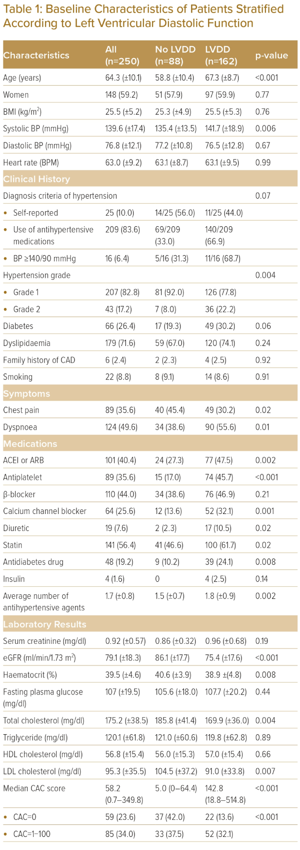
Kiel P, Laoakkha W, Boonyasirinant T, Kaolawanich Y
Baseline Characteristics of Patients Stratified According to Left Ventricular Diastolic Function
Citation: Journal of Asian Pacific Society of Cardiology 2023;2:e35.
https://doi.org/10.15420/japsc.2023.13

