Slide 1
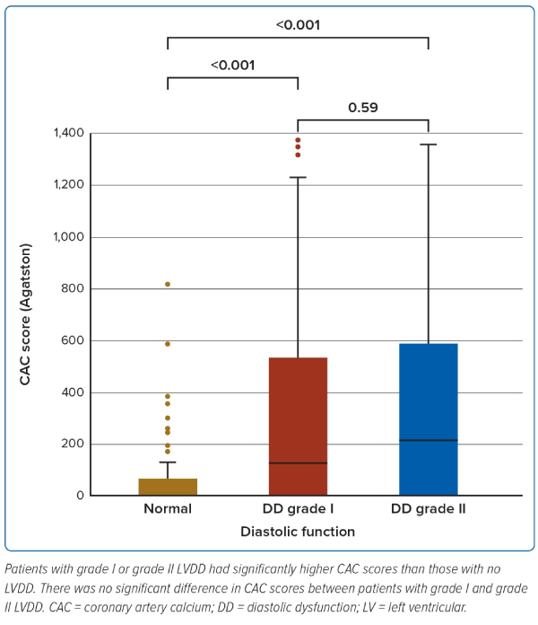
Kiel P, Laoakkha W, Boonyasirinant T, Kaolawanich Y
Figure 1: The Coronary Artery Calcium Scores of Patients Categorised by Left Ventricular Diastolic Dysfunction Grade
Citation: Journal of Asian Pacific Society of Cardiology 2023;2:e35.
https://doi.org/10.15420/japsc.2023.13

