Slide 1
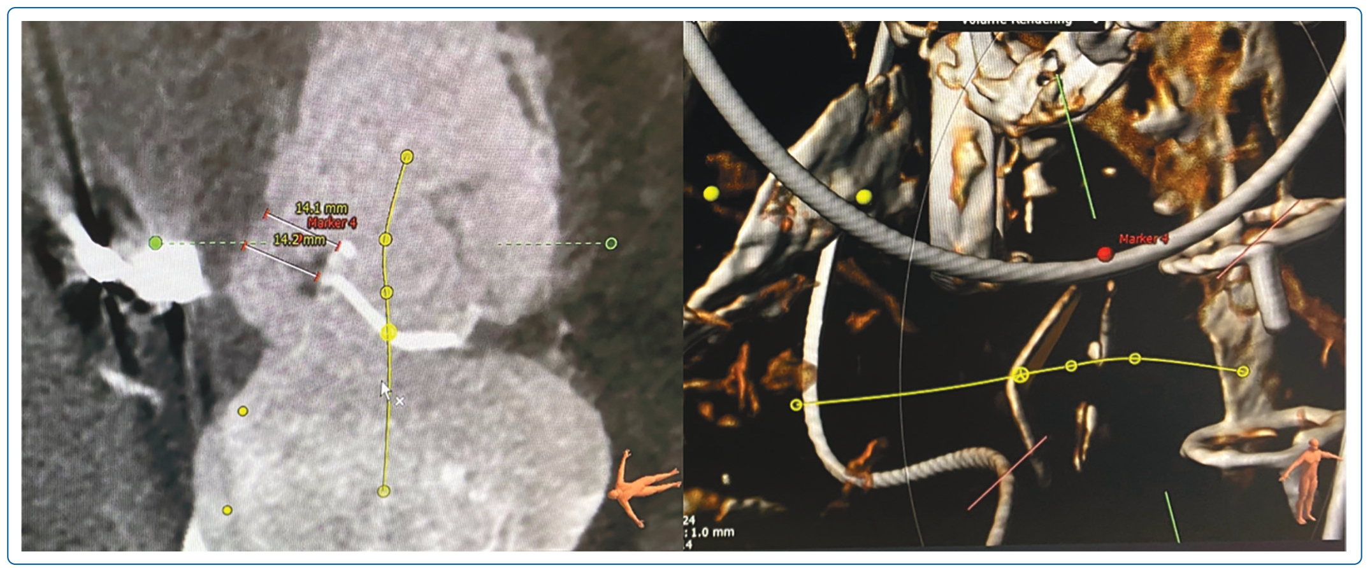
Lim FY, Teck Lee P, Ewe SH, Tan JW, Soo Teik L, Yap JJL
Figure 2: CT of Tricuspid Percutaneous Paravalvular Leak
Citation: Journal of Asian Pacific Society of Cardiology 2023;2:e36.
https://doi.org/10.15420/japsc.2022.45

