Slide 1
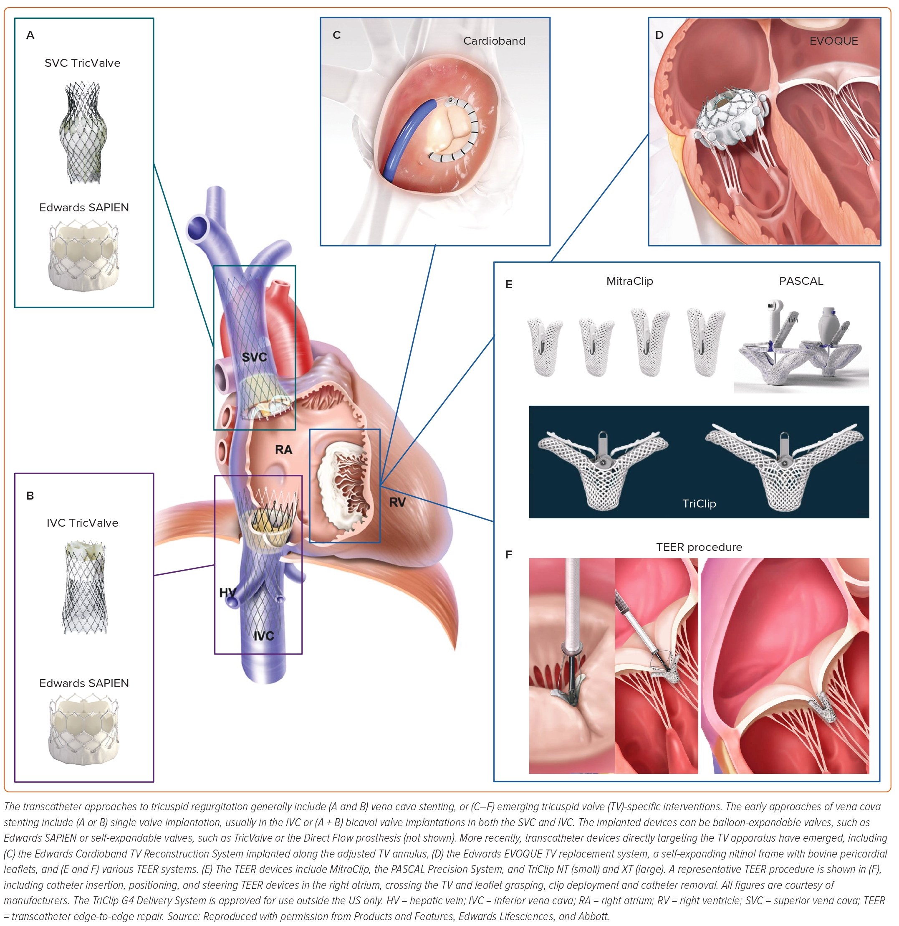
Martin Zhu Q, Berry N
Figure 1: Devices for Percutaneous Tricuspid Regurgitation Therapy, Classified by Anatomical Locations
Citation: European Cardiology Review 2023;18:e55.
https://doi.org/10.15420/ecr.2023.09

