Slide 1

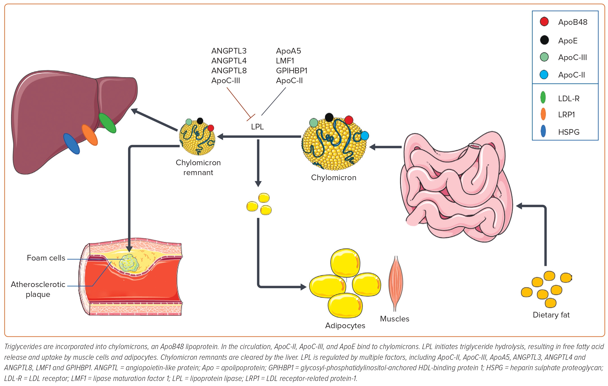
Gabani M, Shapiro MD, Toth PP
Figure 1: Exogenous Pathway (Chylomicron Biosynthesis): The Biosynthesis of Chylomicrons Begins as a Response to Dietary Fat Intake by Jejunal Enterocytes
Citation: European Cardiology Review 2023;18:e56.
https://doi.org/10.15420/ecr.2023.16

