Slide 1
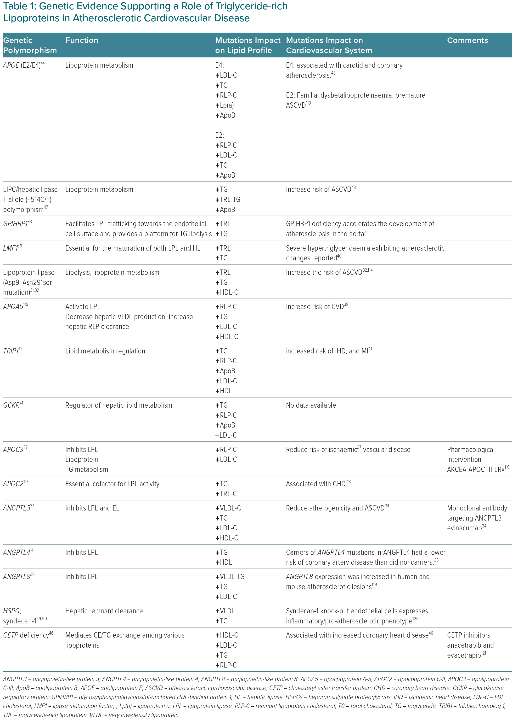
Gabani M, Shapiro MD, Toth PP
Genetic Evidence Supporting a Role of Triglyceride-rich Lipoproteins in Atherosclerotic Cardiovascular Disease
Citation: European Cardiology Review 2023;18:e56.
https://doi.org/10.15420/ecr.2023.16

