Slide 1
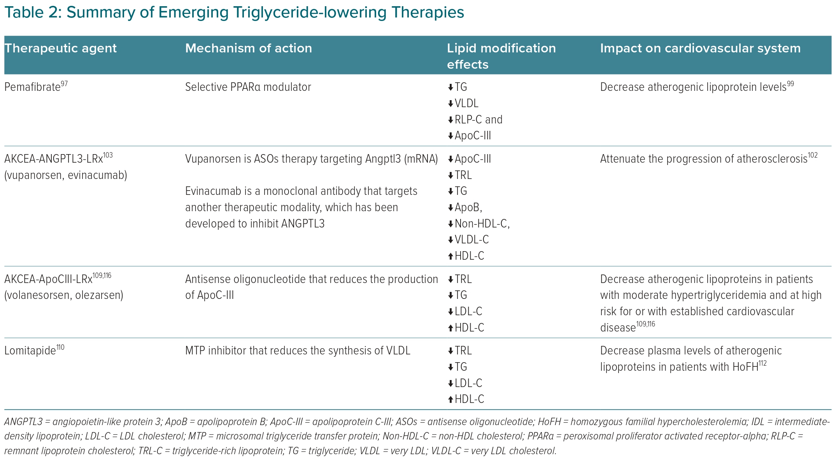
Gabani M, Shapiro MD, Toth PP
Summary of Emerging Triglyceride-lowering Therapies
Citation: European Cardiology Review 2023;18:e56.
https://doi.org/10.15420/ecr.2023.16

