Slide 1
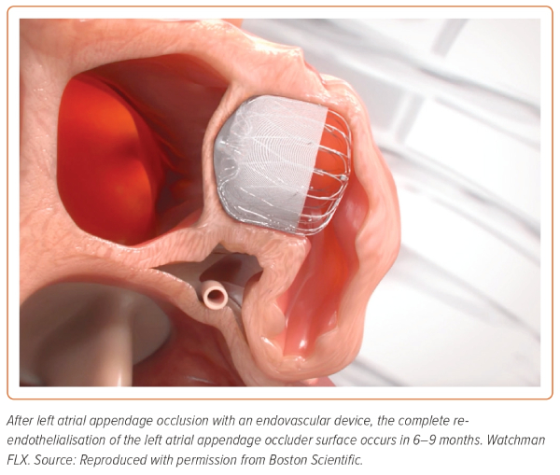
Merella P, Talanas G, Lorenzoni G, Denurra C, Atzori E, Casu G
Figure 4: Endothelialisation of the Left Atrial Appendage Occluder Surface
Citation: European Cardiology Review 2023;18:e57
https://doi.org/10.15420/ecr.2023.18

