Slide 1
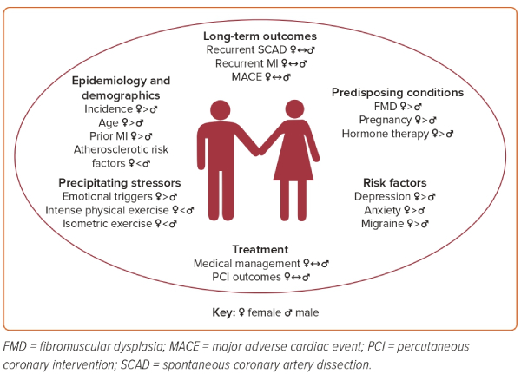
Mustapha AF, Goebel AM, Wells BJ
Figure 2: Sex and Gender Differences and Similarities in the Epidemiology, Risk Factors, Treatments, and Outcomes of Spontaneous Coronary Artery Dissection
Citation: US Cardiology Review 2023;17:e15.
https://doi.org/10.15420/usc.2023.02

