Slide 1
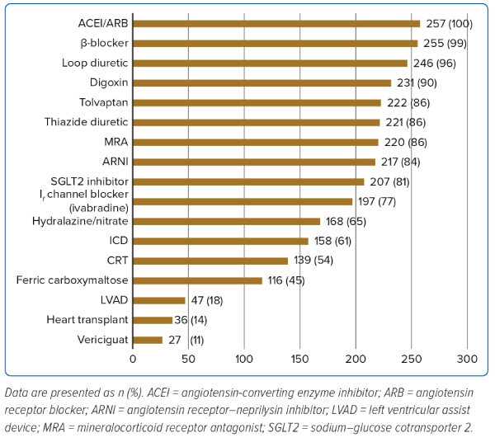
Lin W, Sim D, Pin LC, Teo L, Sindone A, Prameswari HS, Aw TC, Jayagopal P, Tan JW
Figure 1: Responses to the Question ‘Which of these heart failure therapeutic options are available at your hospital? (Select all applicable options)’
Citation: Journal of Asian Pacific Society of Cardiology 2023;2:e37.
https://doi.org/10.15420/japsc.2023.07

