Slide 1
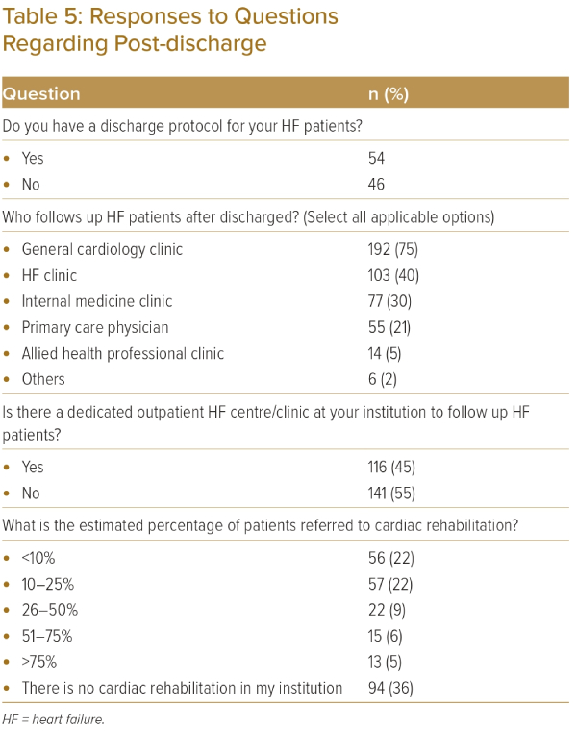
Lin W, Sim D, Pin LC, Teo L, Sindone A, Prameswari HS, Aw TC, Jayagopal P, Tan JW
Responses to Questions Regarding Post-discharge
Citation: Journal of Asian Pacific Society of Cardiology 2023;2:e37.
https://doi.org/10.15420/japsc.2023.07

