Slide 1
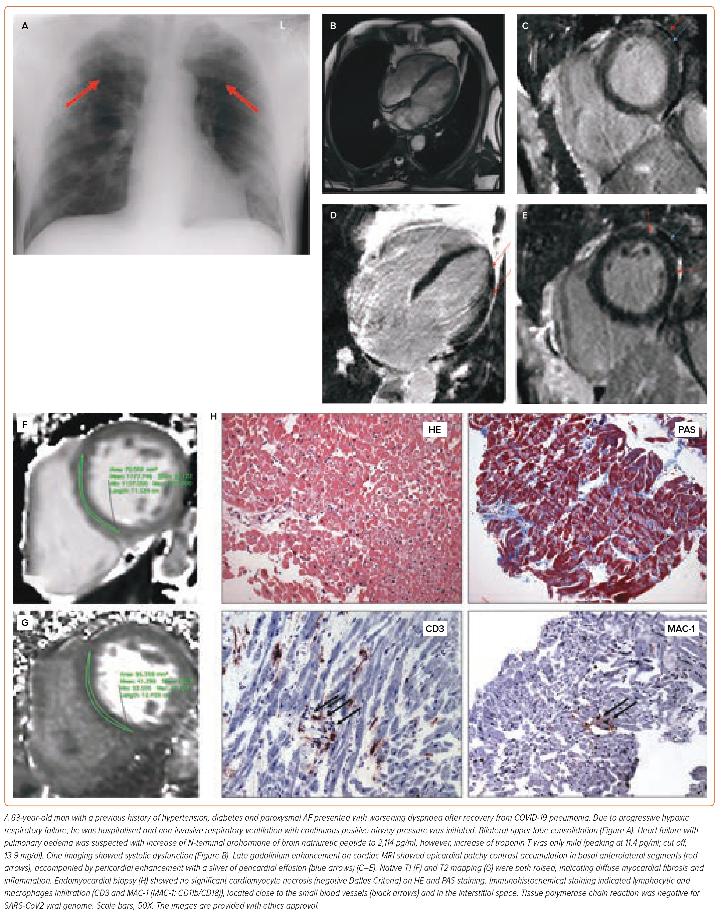
Puntmann VO, Shchendrygina A, Rodriguez Bolanos C, Madjiguène Ka M, Valbuena-López S, Rolf A, Escher F, Nagel E
Figure 3: Post-acute Cardiovascular Sequelae of COVID-19 – Cardiovascular Disease
Citation: European Cardiology Review 2023;18:e58.
https://doi.org/10.15420/ecr.2023.02

