Slide 1
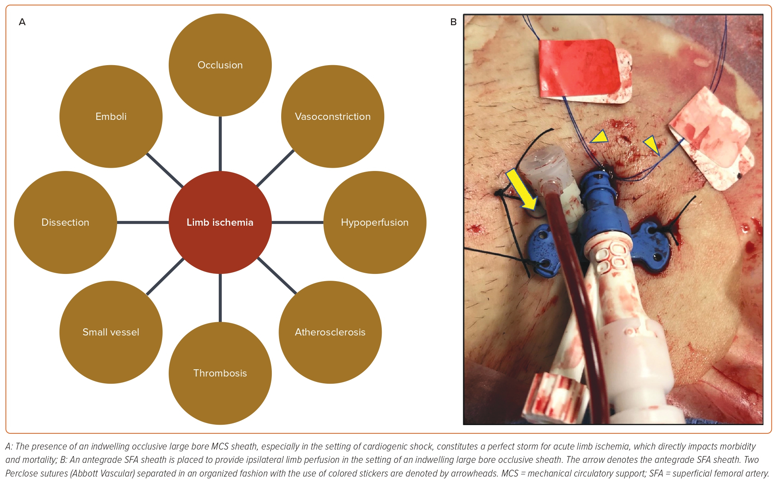
Kerrigan J, Paul TK, Patel J, Saad W, Morse A, Haddad E, Chandler A, Emling J, Lichaa H
Figure 3: Pathophysiology and Prevention of Limb Ischemia in the Setting of Occlusive Large Bore Sheath
Citation: US Cardiology Review 2023;17:e16.
https://doi.org/10.15420/usc.2023.04

