Slide 1
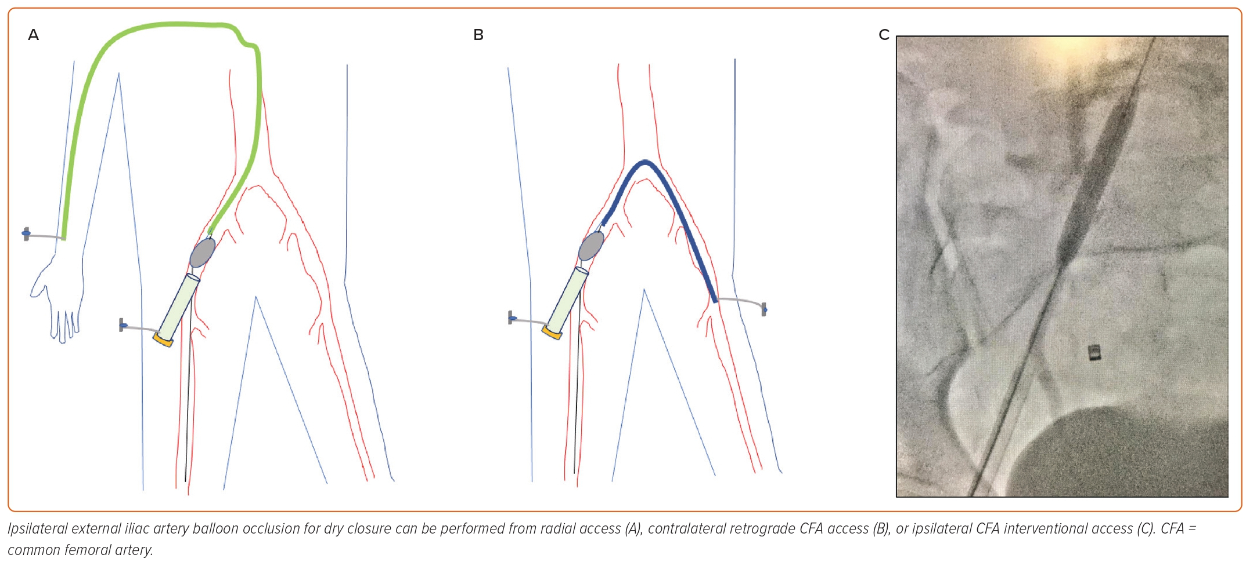
Kerrigan J, Paul TK, Patel J, Saad W, Morse A, Haddad E, Chandler A, Emling J, Lichaa H
Figure 4: Femoral Dry Closure Techniques
Citation: US Cardiology Review 2023;17:e16.
https://doi.org/10.15420/usc.2023.04

