Slide 1
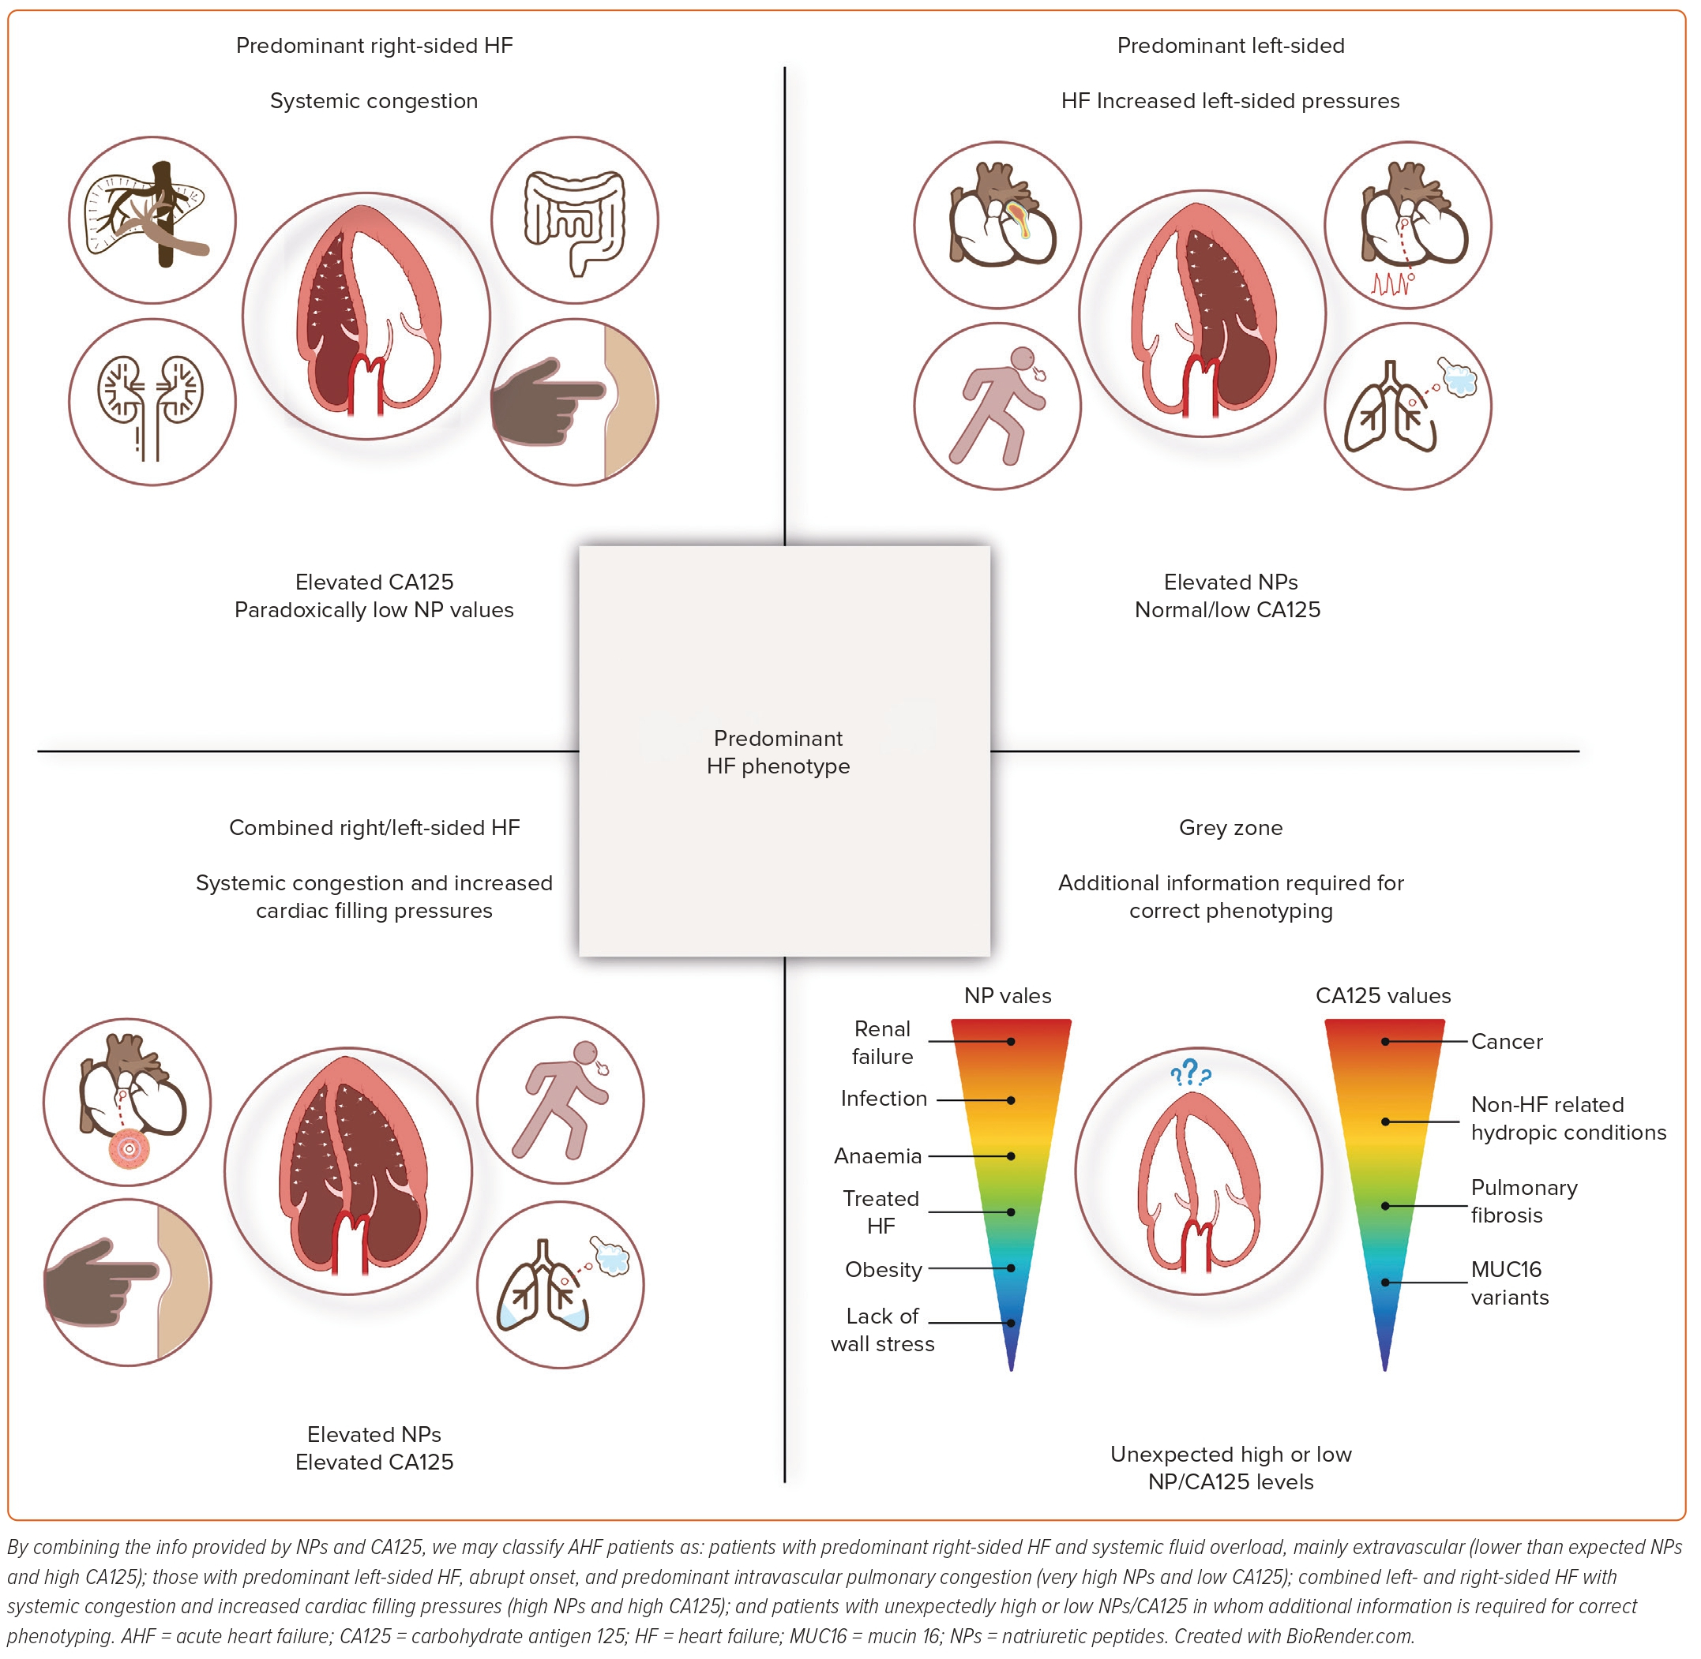
de la Espriella R, Núñez-Marín G, Codina P, Núñez J, Bayés-Genís A
Figure 5: Multibiomarker Panel for Identifying the Predominant Heart Failure Phenotype
Citation: Cardiac Failure Review 2023;9:e13.
https://doi.org/10.15420/cfr.2023.08

