Slide 1
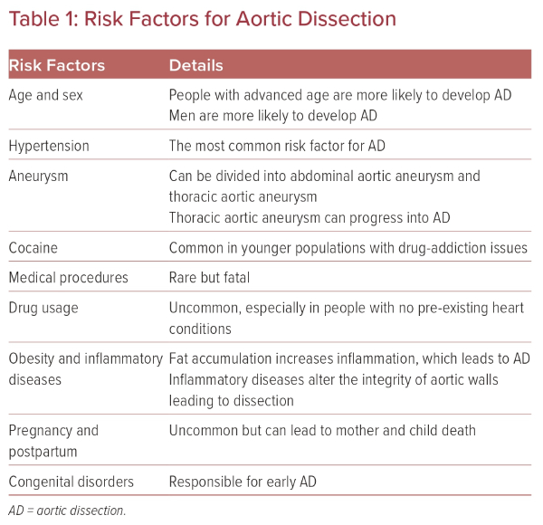
Djodjo Kano H, Sun W
Risk Factors for Aortic Dissection
Citation: US Cardiology Review 2023;17:e17.
https://doi.org/10.15420/usc.2022.36

