Slide 1
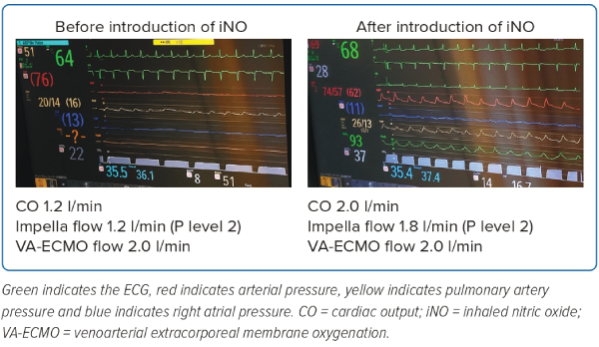
Ikeda Y, Maemura K, Takigami Y, Eda Y, Oki T, Yazaki M, Fujita T, Iida Y, Sato N, Ishii S
Figure 4: Monitoring Screens Before and After Inhaled Nitric Oxide Introduction (Patient 1)
Citation: Journal of Asian Pacific Society of Cardiology 2023;2:e38.
https://doi.org/10.15420/japsc.2022.54

