Slide 1
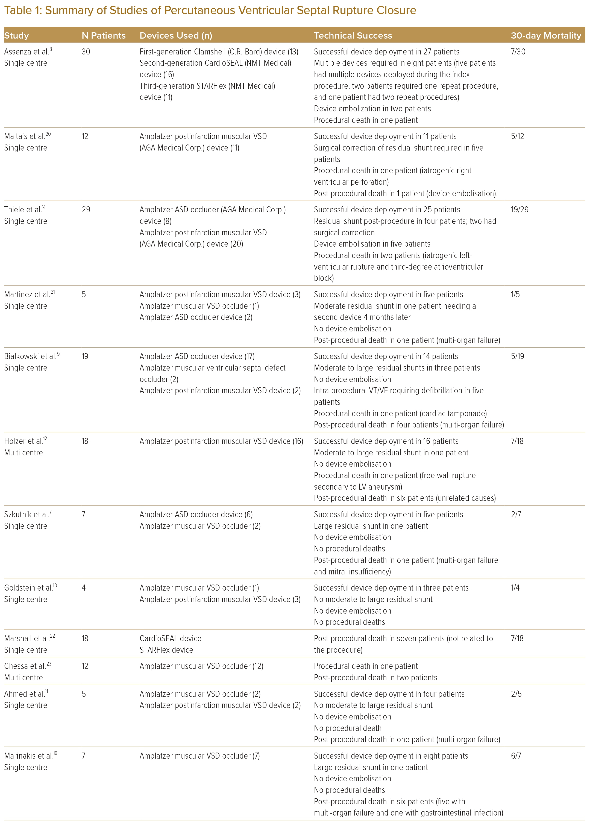
Anbalakan K, Yap JJL, Foo JS, Yan L, Teck Lee P, Soo Teik L, Le Tan J
Summary of Studies of Percutaneous Ventricular Septal Rupture Closure
Citation: Journal of Asian Pacific Society of Cardiology 2023;2:e39
https://doi.org/10.15420/japsc.2023.12

