Slide 1
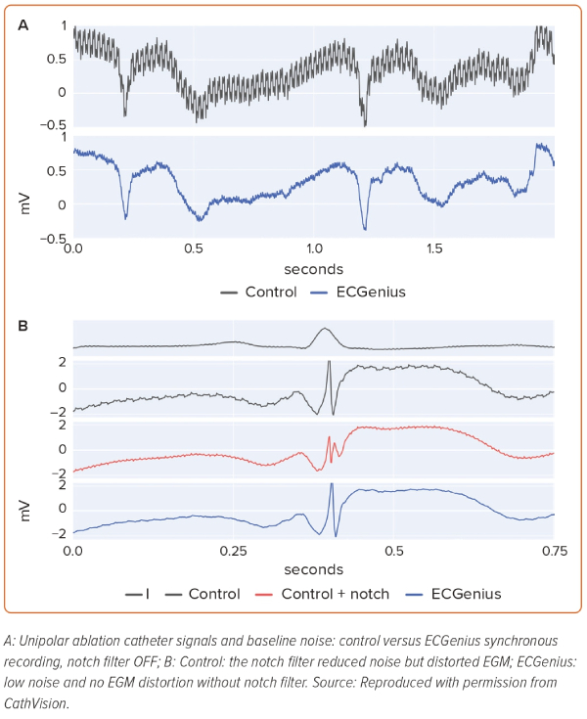
Kautzner J, Peichl P, Paamand R, Carlson MD
Figure 1: Unipolar Noise Levels and Notch Filter-induced Electrogram Distortions
Citation: European Cardiology Review 2023;18:e59.
https://doi.org/10.15420/ecr.2022.37

