Slide 1
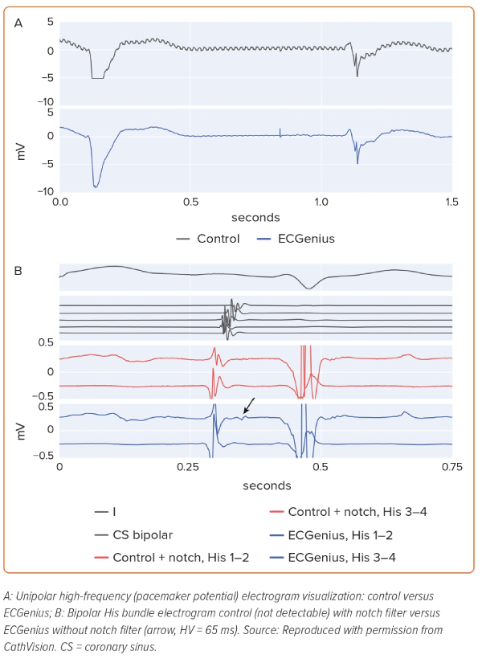
Kautzner J, Peichl P, Paamand R, Carlson MD
Figure 2: Differences in Visibility of Pacemaker Potential and Low-voltage Electrograms
Citation: European Cardiology Review 2023;18:e59.
https://doi.org/10.15420/ecr.2022.37

