Slide 1
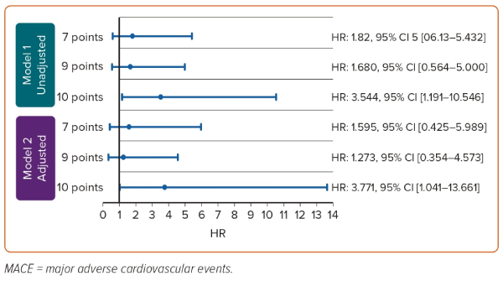
Keat Tan C, Bin-Chia Wu D, Yi Joseph Tan S, Saqib Imran S, Ting Wee X, Tan DSY
Figure 2: ABCD-GENE Cut-off Scores versus 1-year Risk of MACE
Citation: European Cardiology Review 2023;18:e60.
https://doi.org/10.15420/ecr.2023.27

