Slide 1
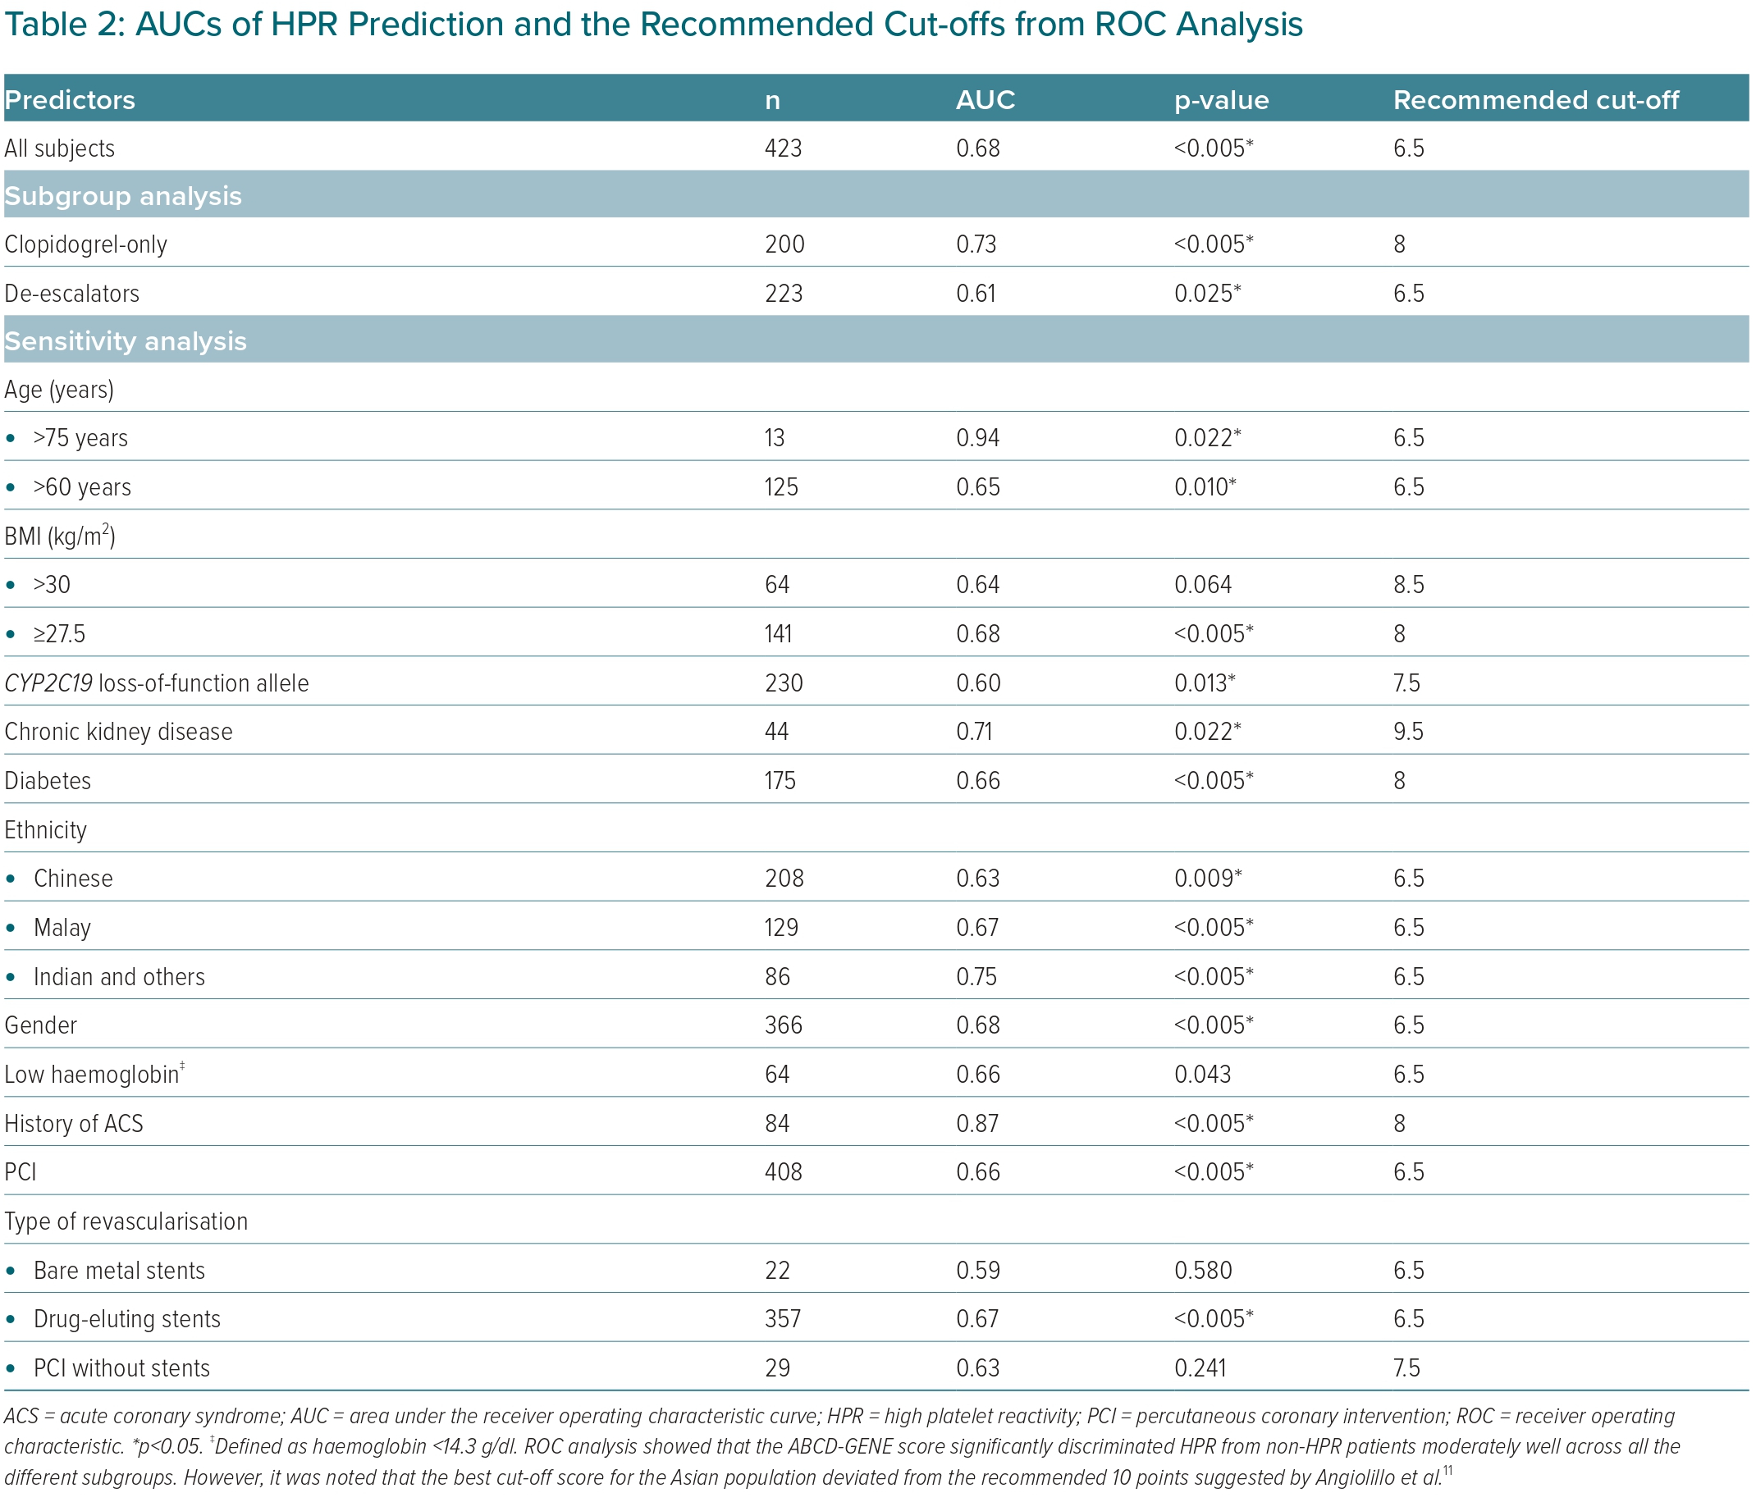
Keat Tan C, Bin-Chia Wu D, Yi Joseph Tan S, Saqib Imran S, Ting Wee X, Tan DSY
AUCs of HPR Prediction and the Recommended Cut-offs from ROC Analysis
Citation: European Cardiology Review 2023;18:e60.
https://doi.org/10.15420/ecr.2023.27

