Slide 1
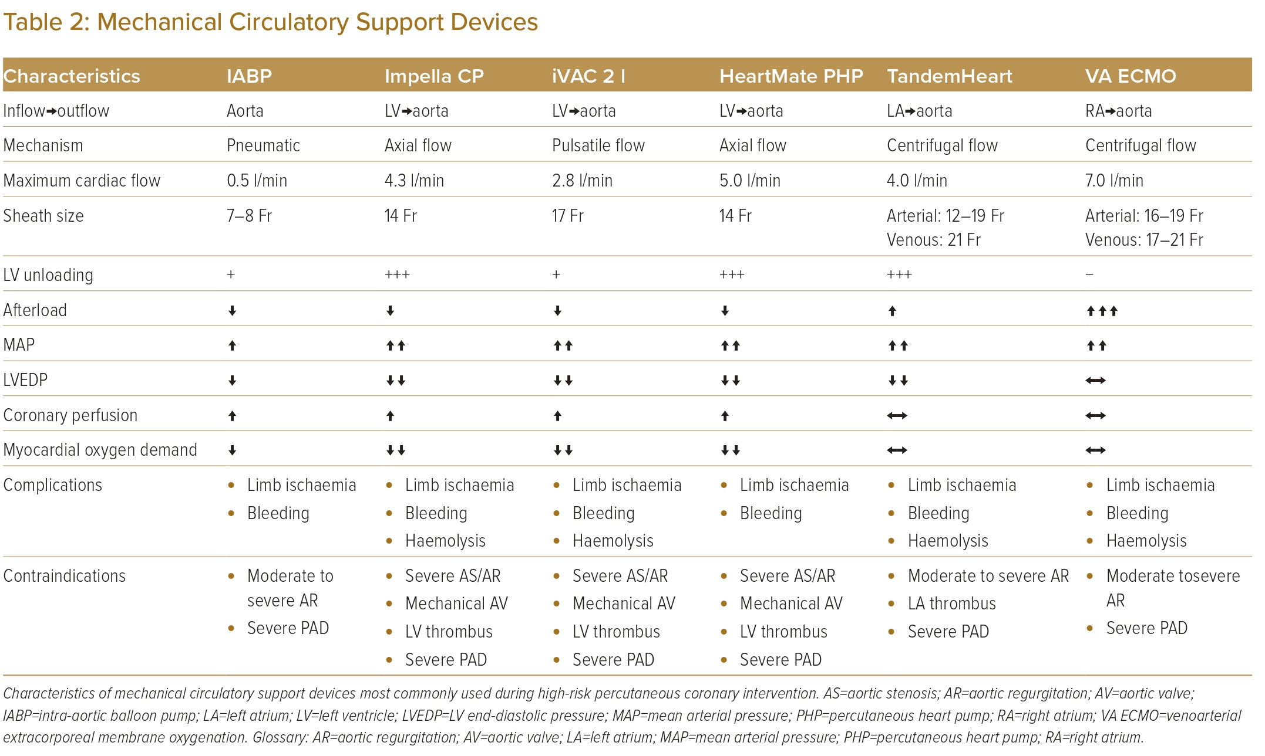
Gabriel Sung J, Lam H, Ka-Lung C, Yiu-Tung Wong A, Yap JJL, Lee ZV, Lo ST, Kochar A, Liew HB, Julian Jensen C, Karthikesan D, Wei-Chieh Tan J, Yam PW, Yeo KK, Park DW, Eeckhout E
Mechanical Circulatory Support Devices
Citation: Journal of Asian Pacific Society of Cardiology 2023;2:e40.
https://doi.org/10.15420/japsc.2023.06

