Slide 1
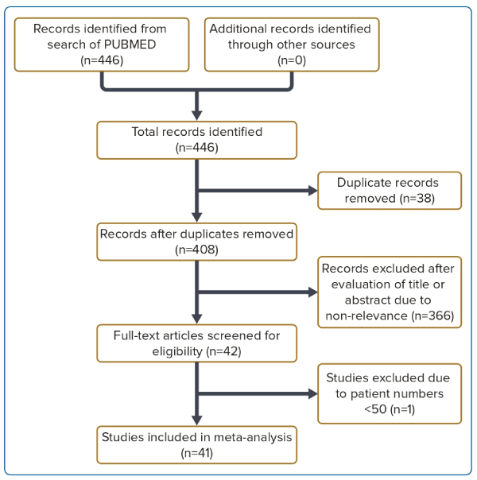
Wong JJ, Gan E, Gao F, Yann Shan K, Rizwan Amanullah M, Soo Teik L, Abdul Aziz Z, Govindasam S, Tar Toong Chao V, Ewe SH, Ho KW, Yap JJL
Figure 1: Flow Diagram of the Study Selection Process.
Citation: Journal of Asian Pacific Society of Cardiology 2023:2;e41.
https://doi.org/10.15420/japsc.2022.33

