Slide 1
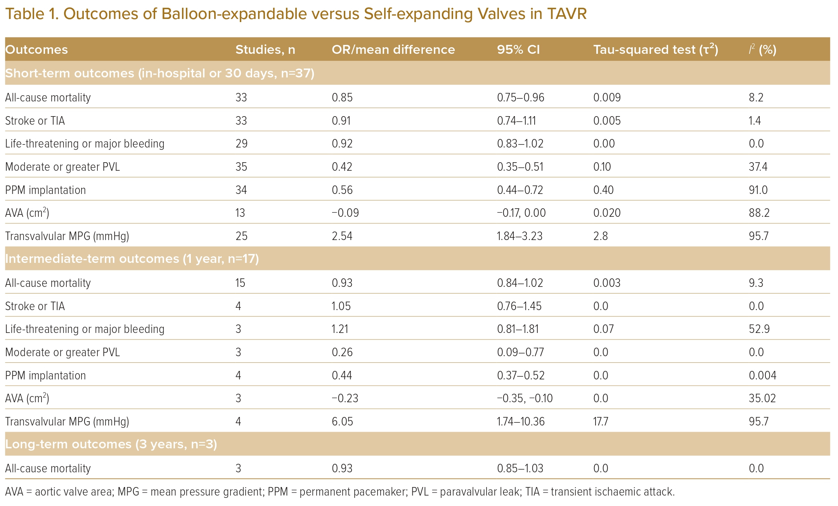
Wong JJ, Gan E, Gao F, Yann Shan K, Rizwan Amanullah M, Soo Teik L, Abdul Aziz Z, Govindasam S, Tar Toong Chao V, Ewe SH, Ho KW, Yap JJL
Outcomes of Balloon-expandable versus Self-expanding Valves in TAVR
Citation: Journal of Asian Pacific Society of Cardiology 2023:2;e41.
https://doi.org/10.15420/japsc.2022.33

