Slide 1
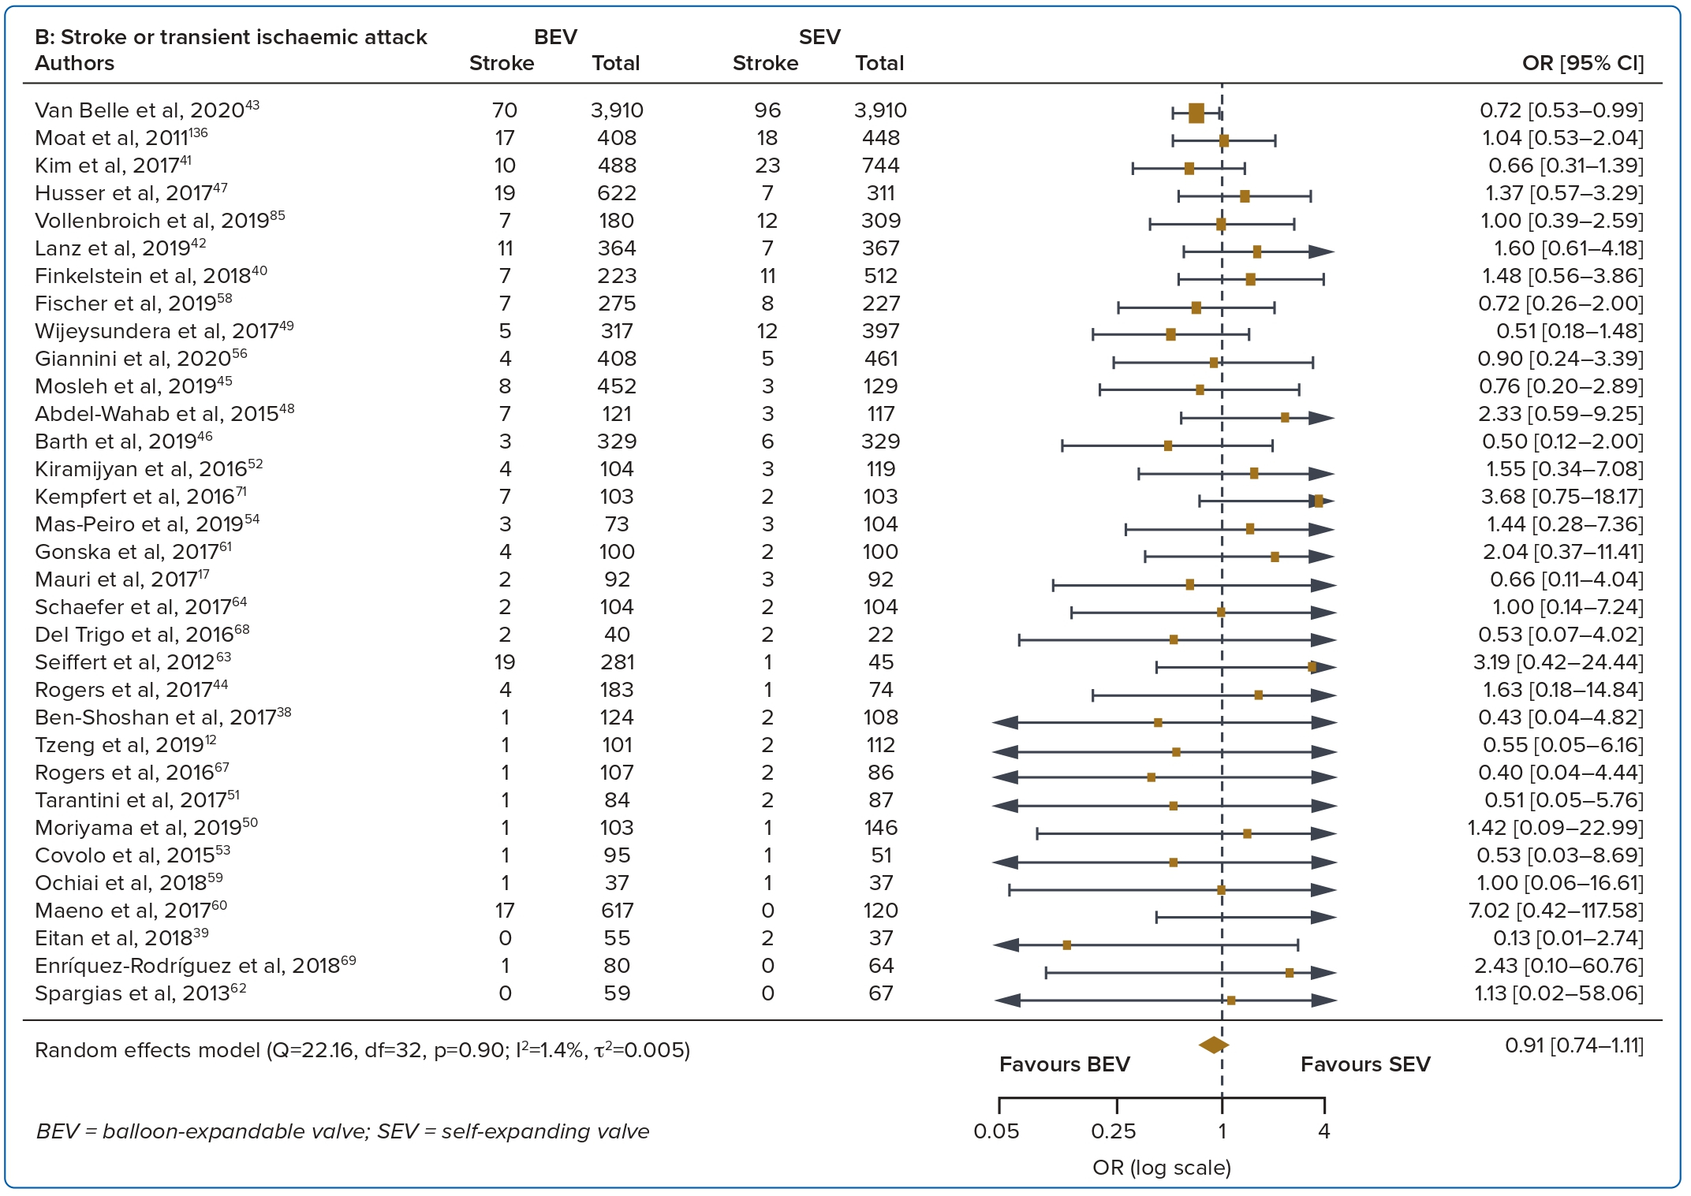
Wong JJ, Gan E, Gao F, Yann Shan K, Rizwan Amanullah M, Soo Teik L, Abdul Aziz Z, Govindasam S, Tar Toong Chao V, Ewe SH, Ho KW, Yap JJL
Figure 2: Cont
Citation: Journal of Asian Pacific Society of Cardiology 2023:2;e41.
https://doi.org/10.15420/japsc.2022.33

