Slide 1
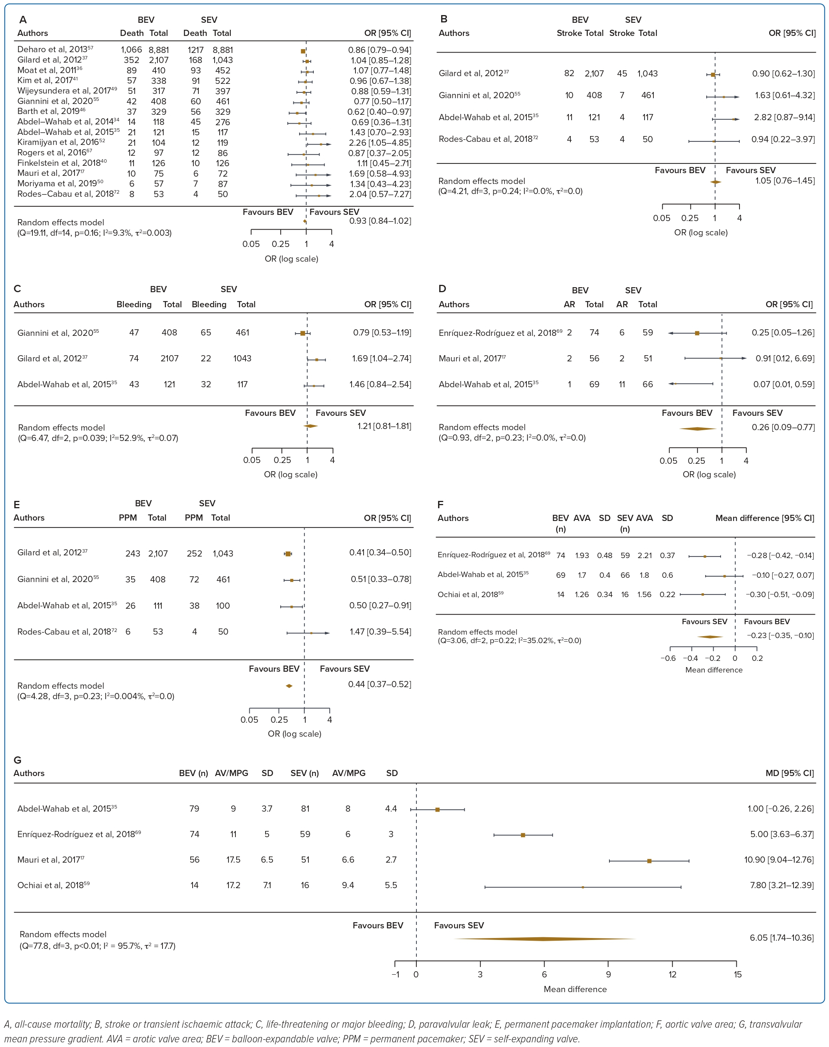
Wong JJ, Gan E, Gao F, Yann Shan K, Rizwan Amanullah M, Soo Teik L, Abdul Aziz Z, Govindasam S, Tar Toong Chao V, Ewe SH, Ho KW, Yap JJL
Figure 3: Forest Plots of Intermediate-term (1-year) Clinical Outcomes.
Citation: Journal of Asian Pacific Society of Cardiology 2023:2;e41.
https://doi.org/10.15420/japsc.2022.33

