Slide 1
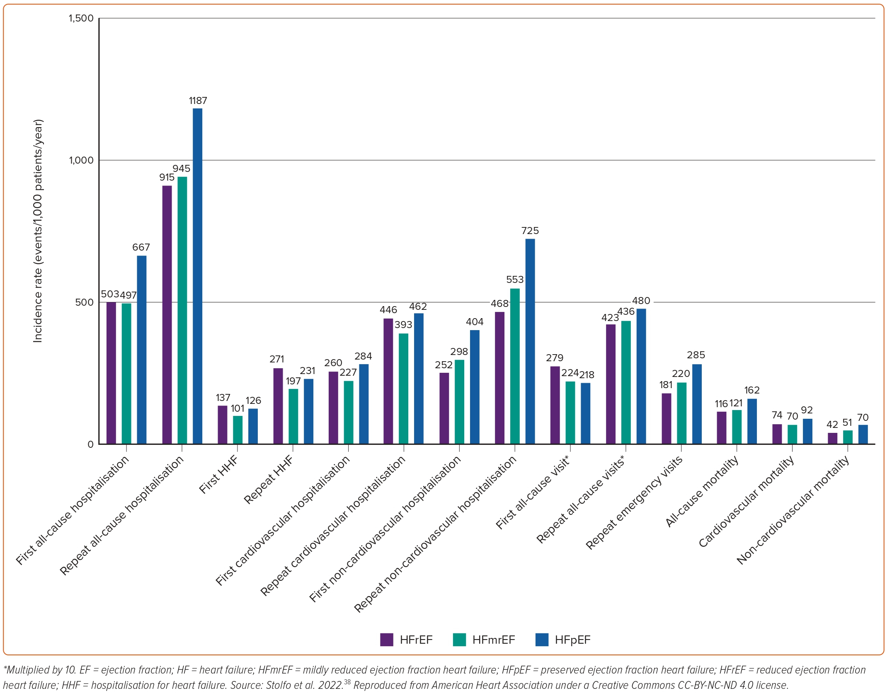
Kapelios CJ, Shahim B, Lund LH, Savarese G
Figure 5: Incidence of the Relevant Heart Failure Outcomes in the Population with Heart Failure across the Ejection Fraction Categories
Citation: Cardiac Failure Review 2023;9:e14.
https://doi.org/10.15420/cfr.2023.03

