Slide 1
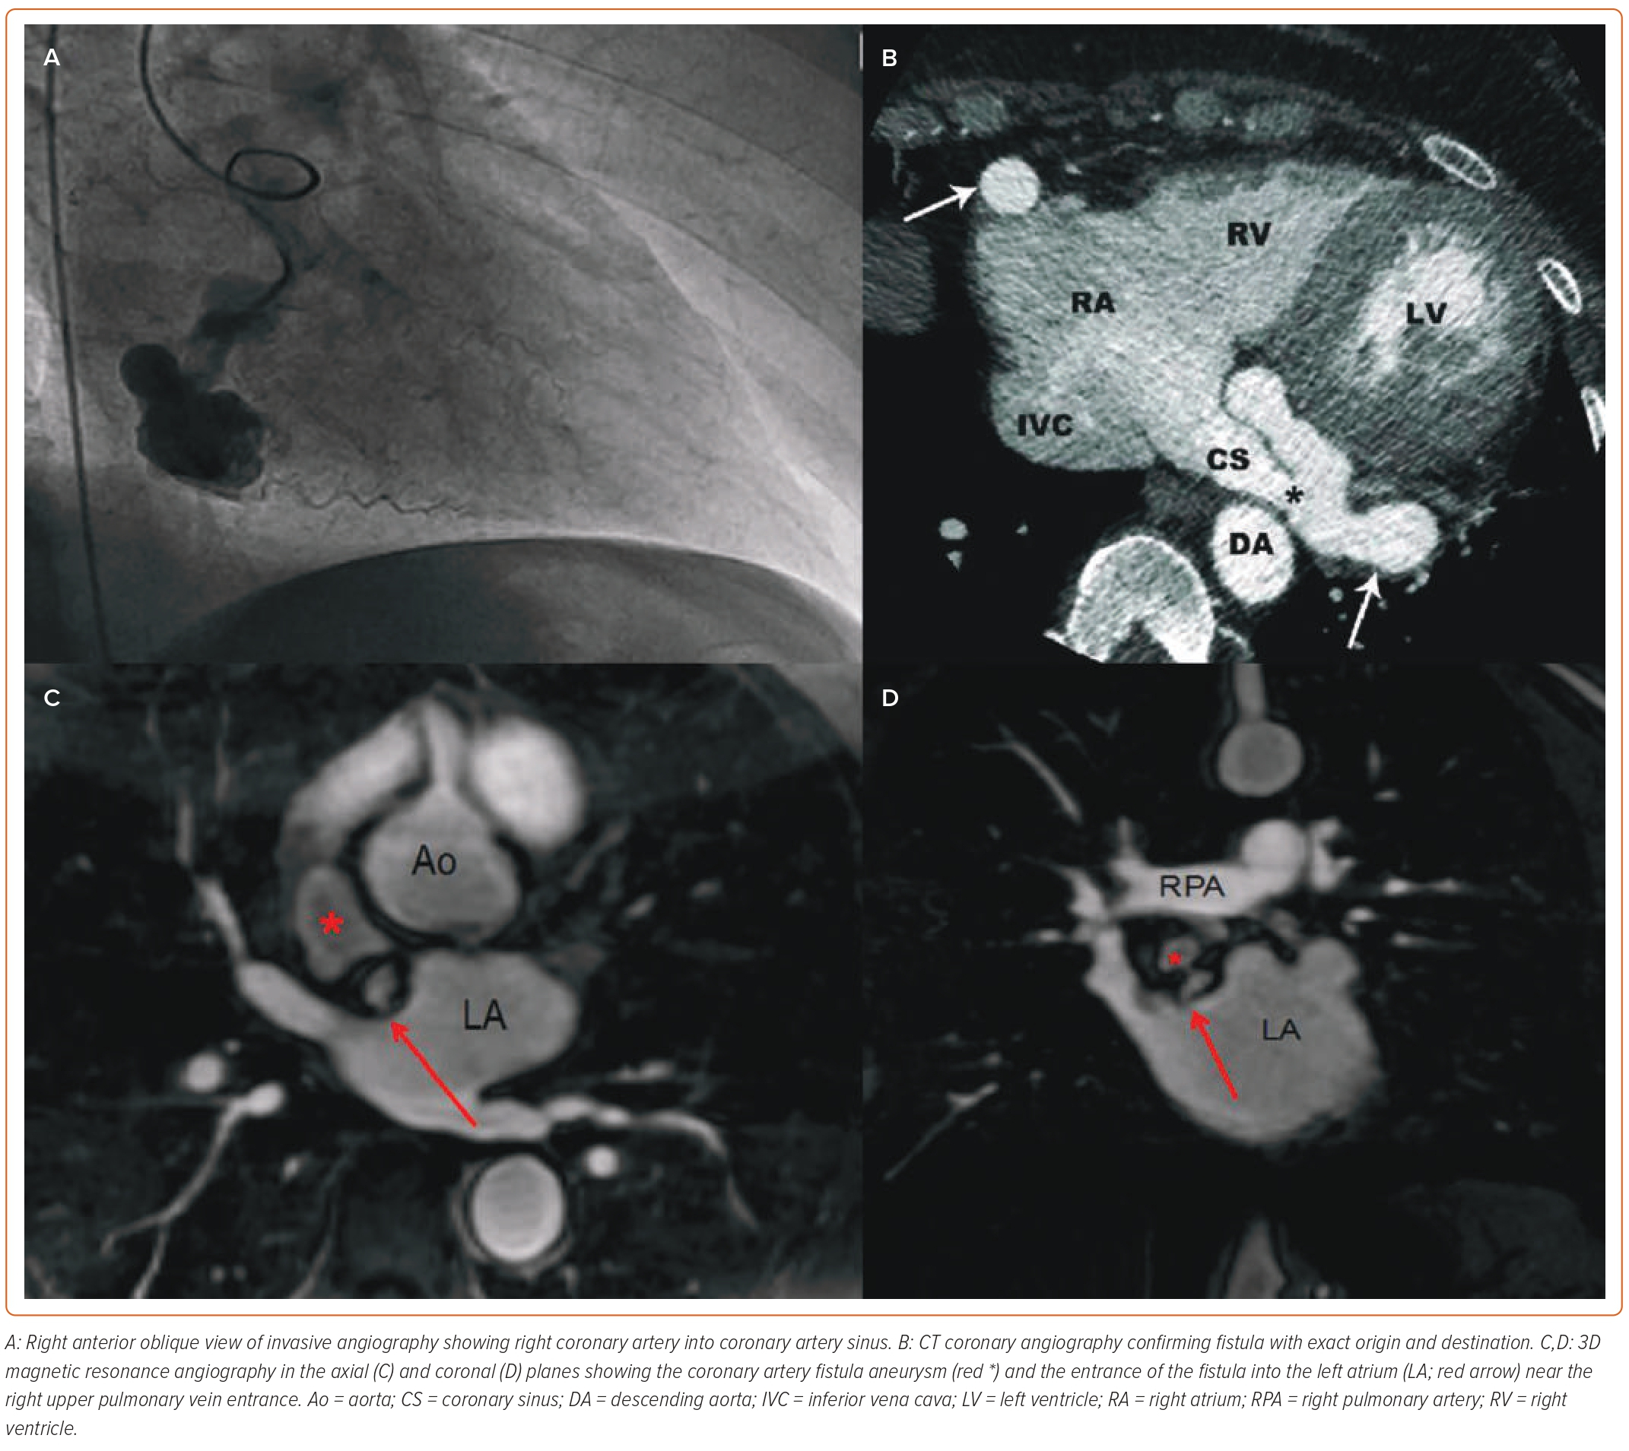
Kumar R, Kumar J, O’Connor C, Ullah I, Tyrell B, Pearson I, Matiullah S, Bainey K
Figure 2: Imaging in the Diagnosis of Coronary Artery Fistula
Citation: Interventional Cardiology 2023;18:e25.
https://doi.org/10.15420/icr.2022.34

