Slide 1
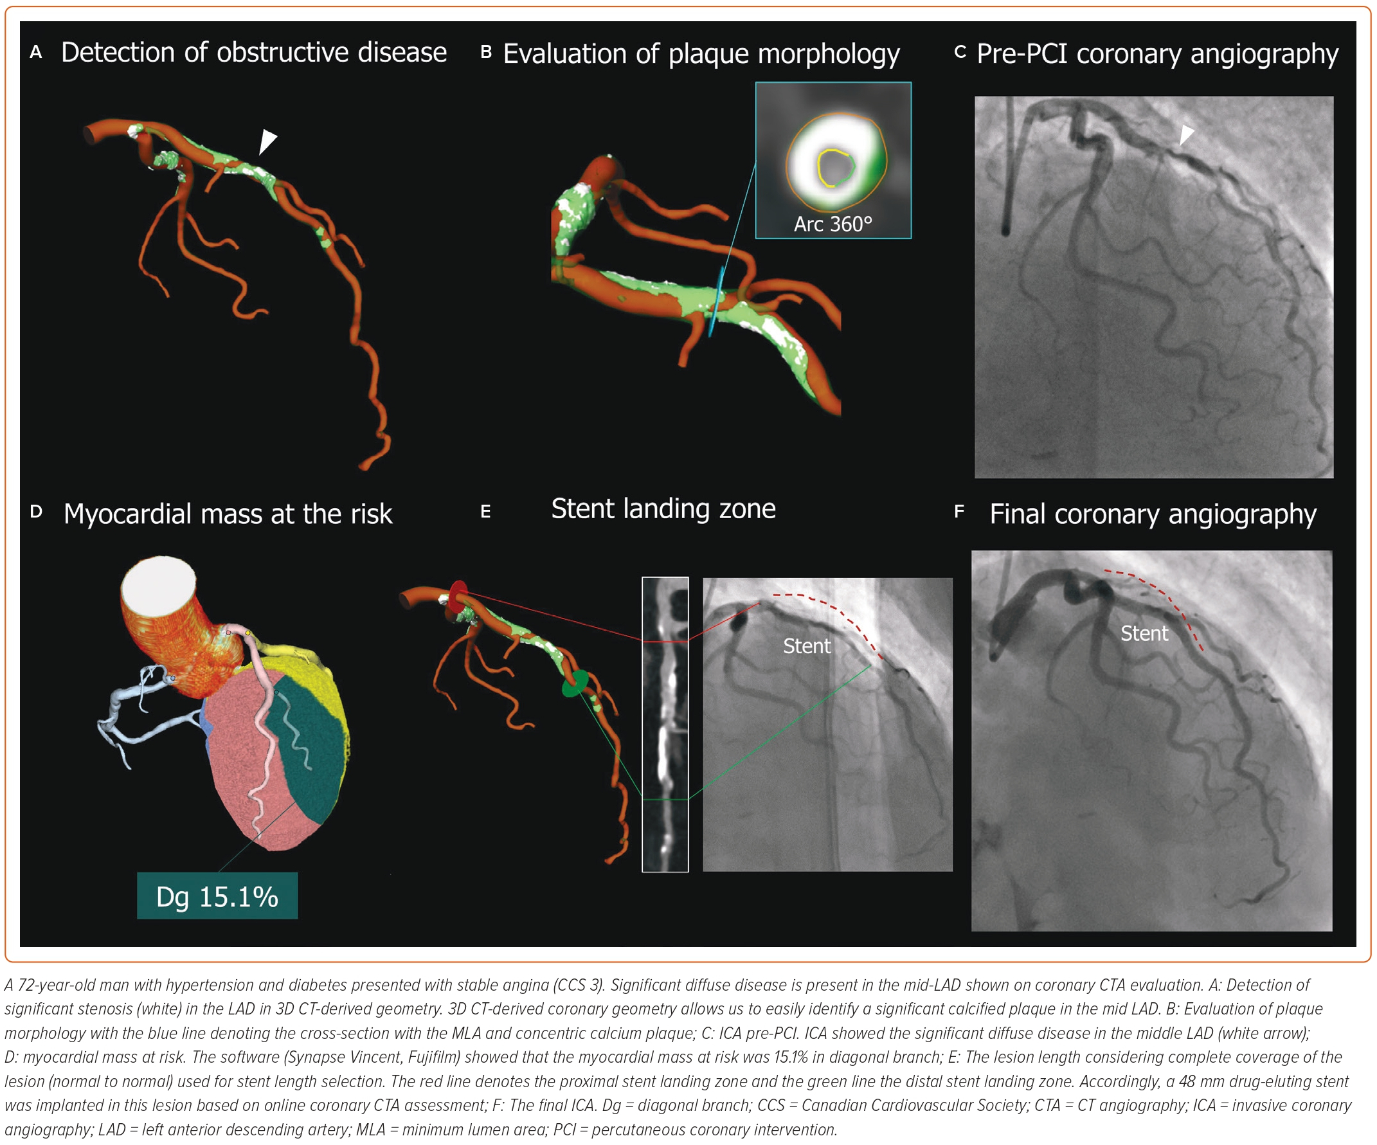
Ohashi H, Bouisset F, Buytaert D, Seki R, Sonck J, Sakai K, Belmonte M, Kitslaar P, Updegrove A, Amano T, Andreini D, De Bruyne B, Collet C
Figure 5: Representative Cases of CT-Guided Percutaneous Coronary Intervention in Complex Lesion
Citation: Interventional Cardiology 2023;18:e26.
https://doi.org/10.15420/icr.2023.12

