Slide 1
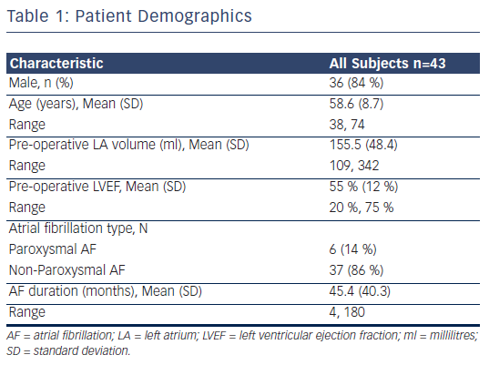
Thosani AJ, Gerczuk P, Liu E, Belden W, Moraca R
Table 1: Patient Demographics
Citation: Arrhythmia & Electrophysiology Review 2013;2(1):65-8
https://doi.org/10.15420/aer.2013.2.1.65

