Slide 1
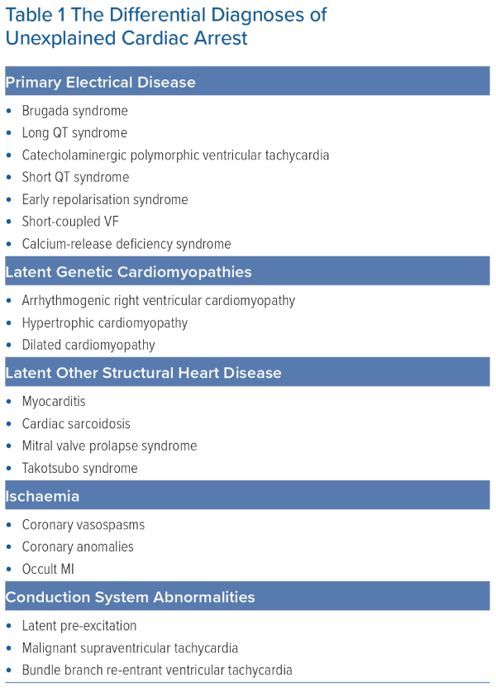
Suna G, Mellor GJ
The Differential Diagnoses of Unexplained Cardiac Arrest
Citation: Arrhythmia & Electrophysiology Review 2023;12:e27
https://doi.org/10.15420/aer.2023.06

