Slide 1
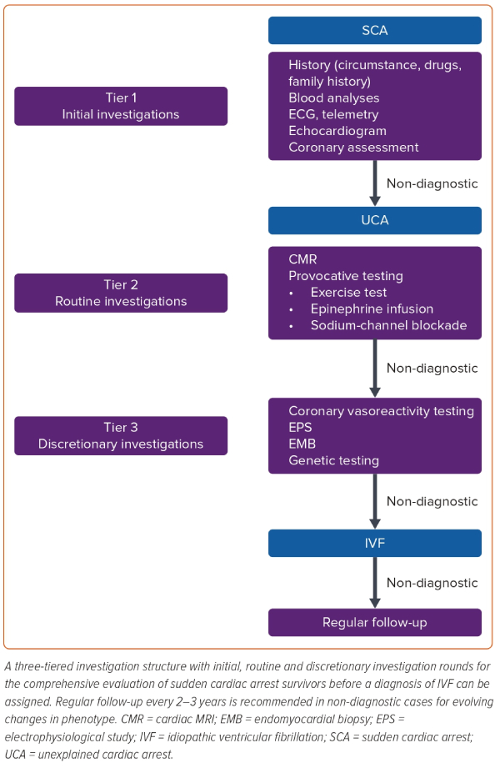
Suna G, Mellor GJ
Figure 2: Diagnostic Algorithm for Sudden Cardiac Arrest Evaluation
Citation: Arrhythmia & Electrophysiology Review 2023;12:e27
https://doi.org/10.15420/aer.2023.06

