Slide 1
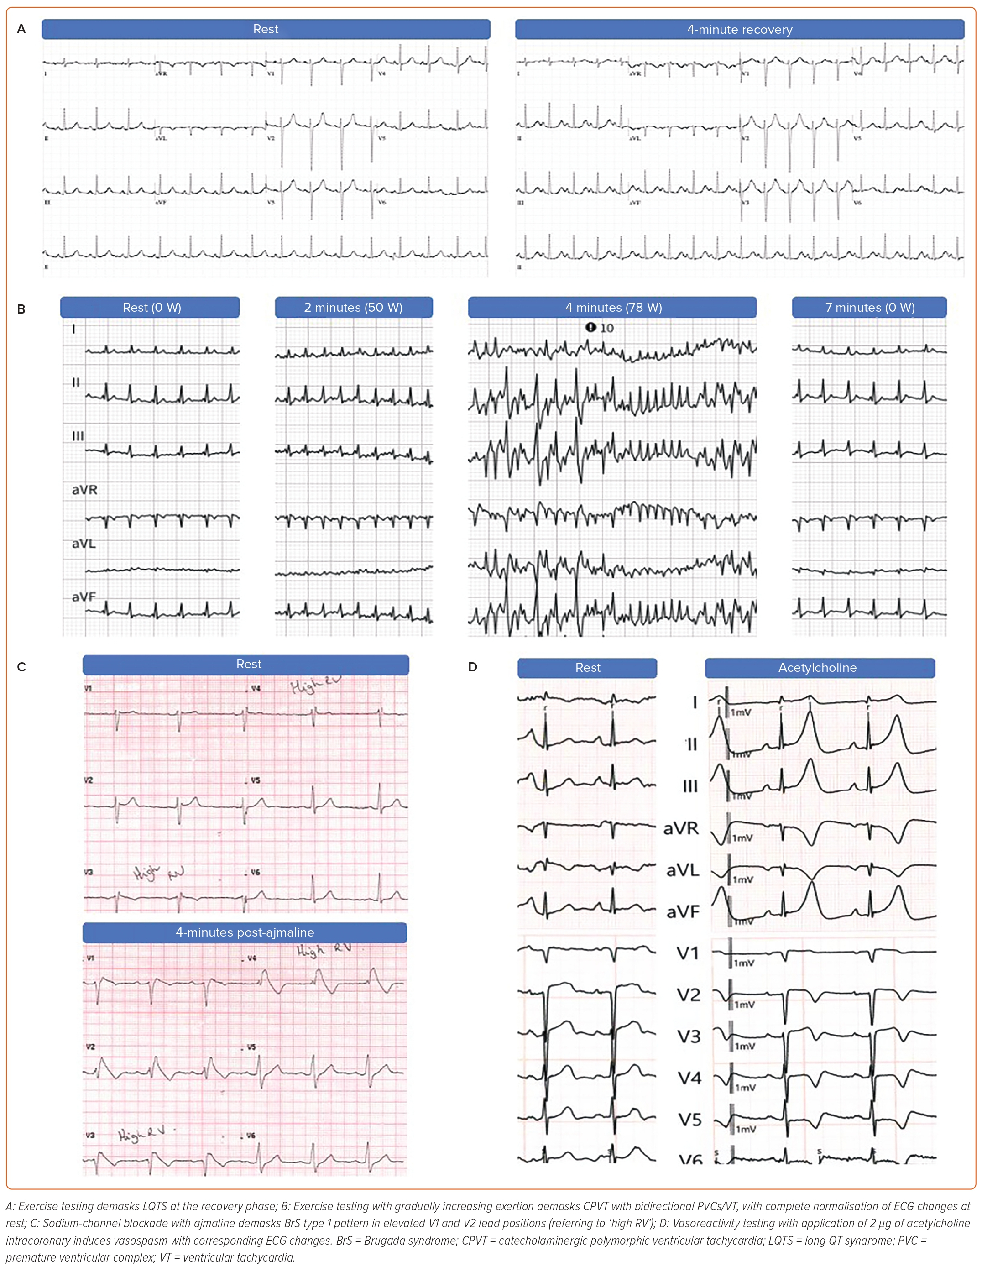
Suna G, Mellor GJ
Figure 4: A Summary of Results from Provocative Testing
Citation: Arrhythmia & Electrophysiology Review 2023;12:e27
https://doi.org/10.15420/aer.2023.06

