Slide 1
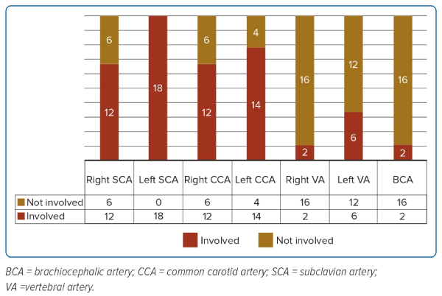
Bagchi A, Tyagi S, Bansal A, Gupta MD, MP G
Figure 1: Pattern of Arch Vessel Involvement
Citation: Journal of Asian Pacific Society of Cardiology 2023;2:e42.
https://doi.org/10.15420/japsc.2023.08

