Slide 1
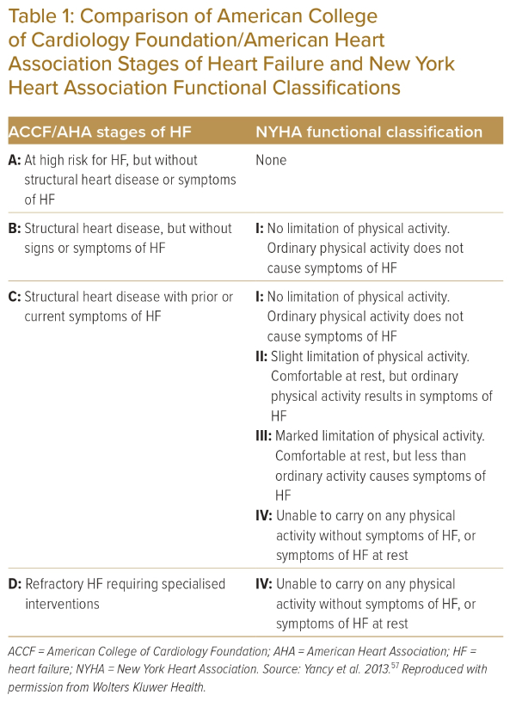
Bahn Kawa L
Comparison of American College of Cardiology Foundation/American Heart Association Stages of Heart Failure and New York Heart Association Functional Classifications
Citation: Journal of Asian Pacific Society of Cardiology 2023;2:e43.
https://doi.org/10.15420/japsc.2023.19

