Slide 1
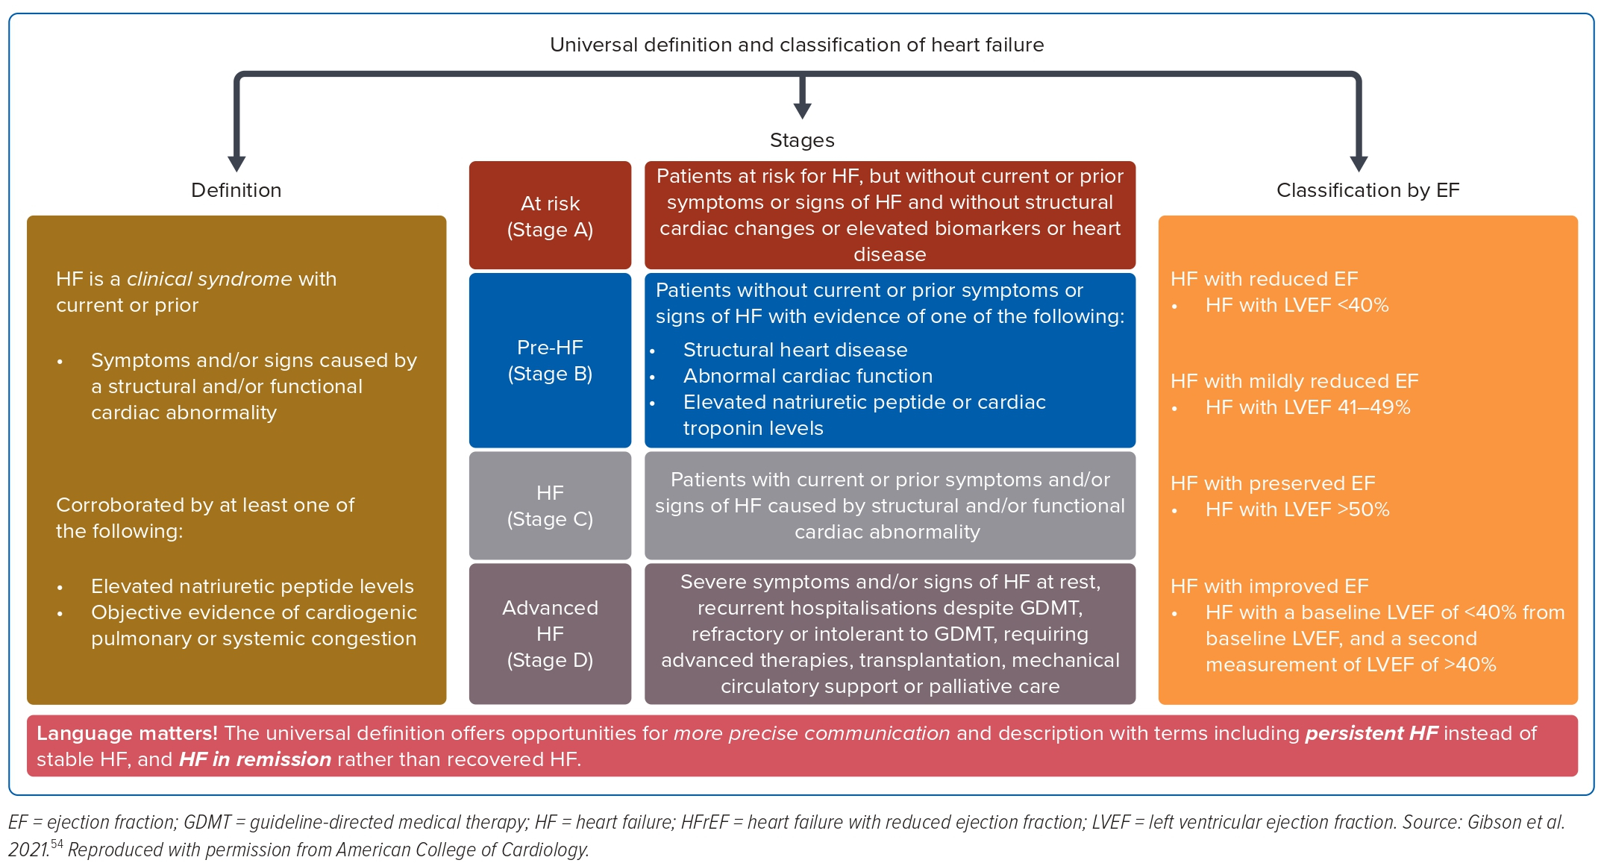
Bahn Kawa L
Figure 1: The Combined Definition and Classification of Heart Failure
Citation: Journal of Asian Pacific Society of Cardiology 2023;2:e43.
https://doi.org/10.15420/japsc.2023.19

