Slide 1
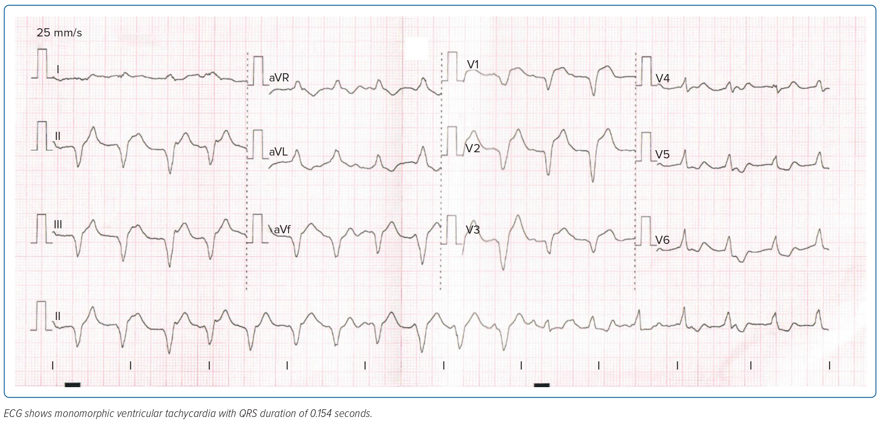
Joseph David B, Tugade RER, Jr Gerodias F
Figure 3: ECG of the Patient on Day 2 of Admission
Citation: Journal of Asian Pacific Society of Cardiology 2023;2:e44.
https://doi.org/10.15420/japsc.2023.23

