Slide 1
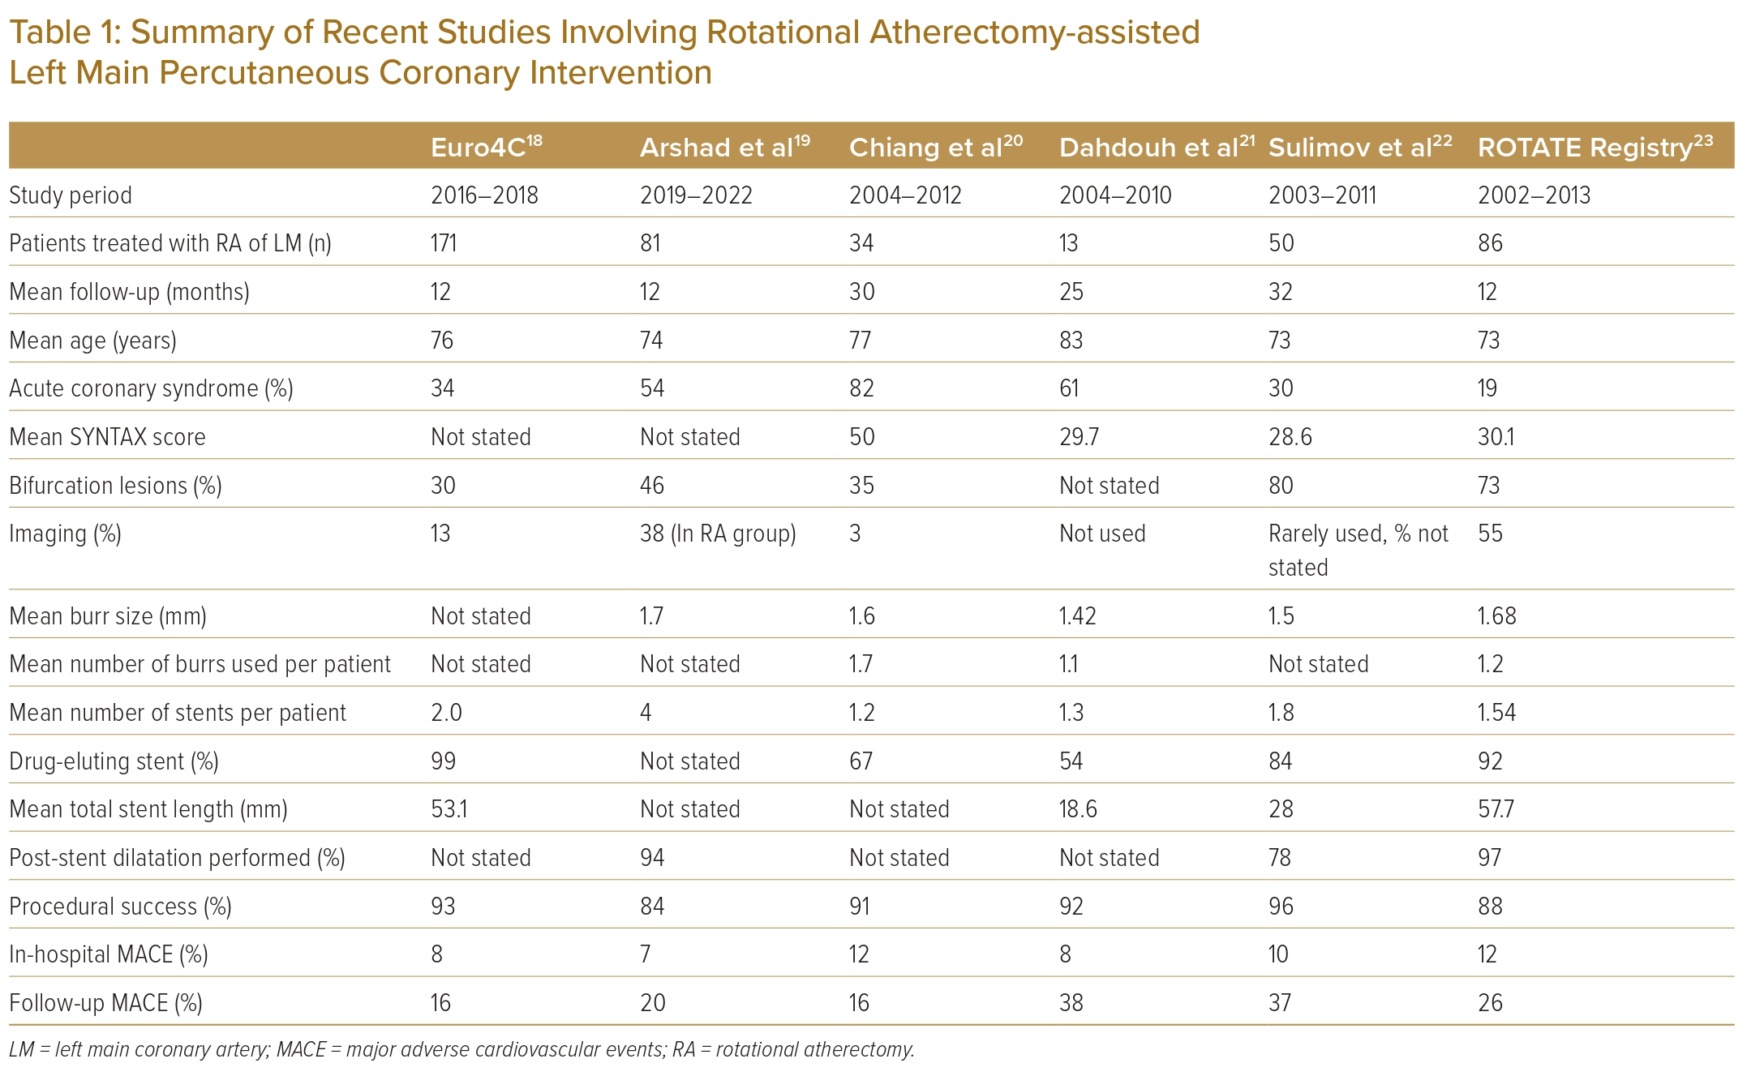
Gupta H, Verma S, Sharma YP, Kaur N, Abhishek Ary K
Summary of Recent Studies Involving Rotational Atherectomy‑assisted Left Main Percutaneous Coronary Intervention
Citation: Journal of Asian Pacific Society of Cardiology 2023;2:e45.
https://doi.org/10.15420/japsc.2023.30

