Slide 1
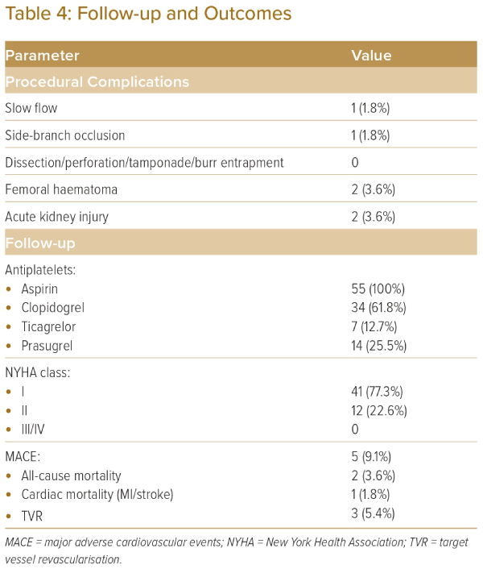
Gupta H, Verma S, Sharma YP, Kaur N, Abhishek Ary K
Follow-up and Outcomes
Citation: Journal of Asian Pacific Society of Cardiology 2023;2:e45.
https://doi.org/10.15420/japsc.2023.30

