Slide 1
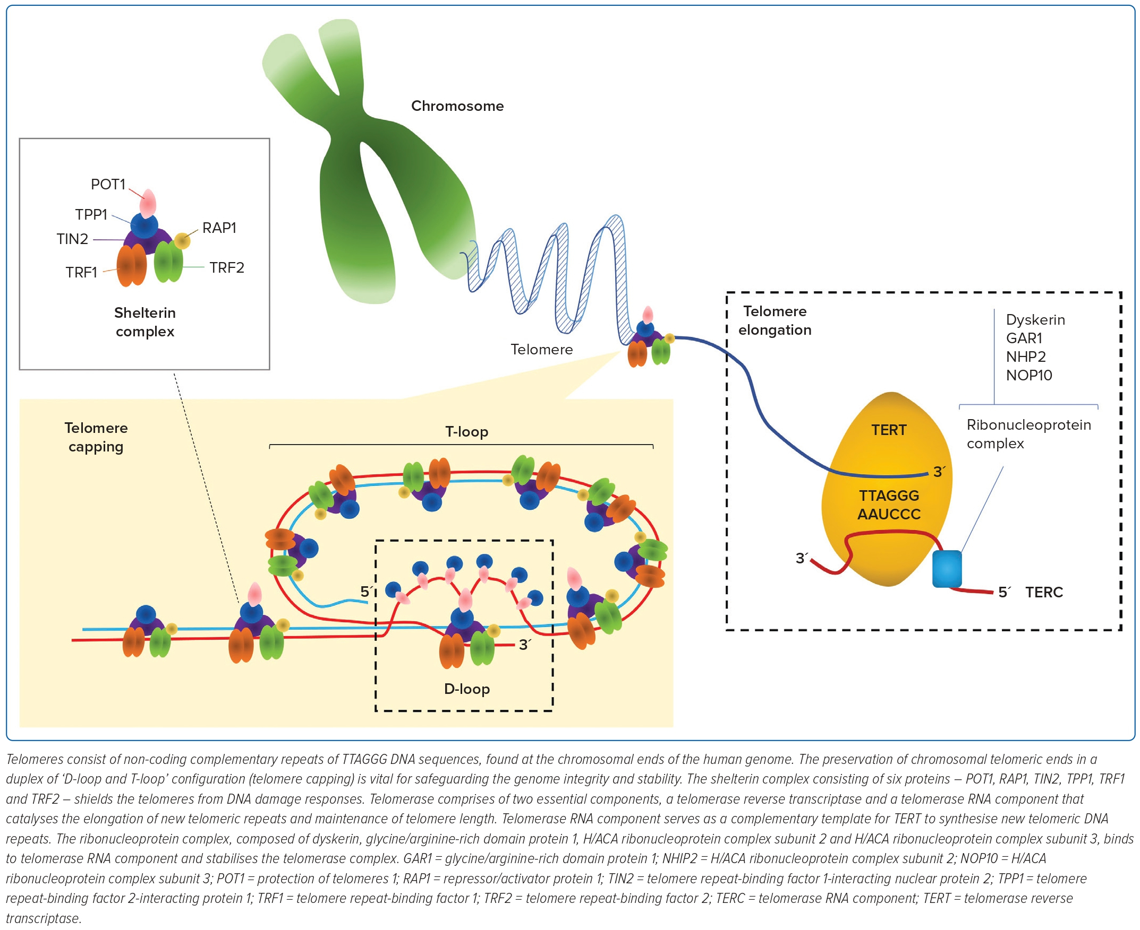
Wen Tan X, Fong AYY, San Hwang S
Figure 1: A General Overview of Telomere Biology
Citation: Journal of Asian Pacific Society of Cardiology 2023;2:e46.
https://doi.org/10.15420/japsc.2023.26

