Slide 1
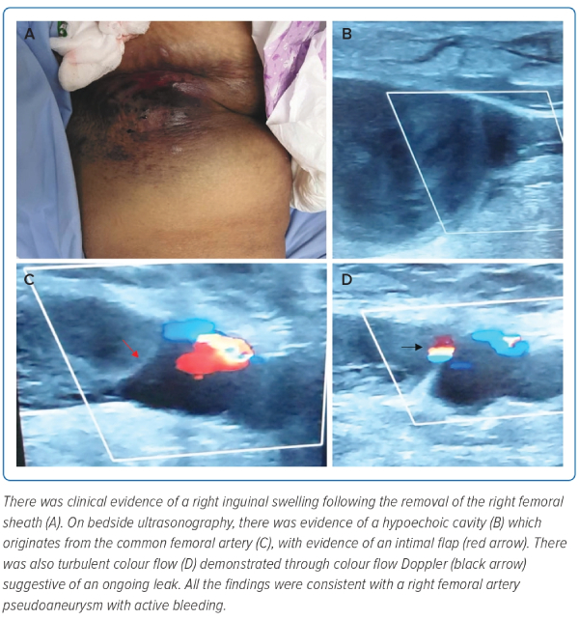
Shariff RER, Najme Khir R, Kasim SS
Figure 1: Right Femoral Haematoma and Bedside Ultrasound of the Haematoma
Citation: Journal of Asian Pacific Society of Cardiology 2023;2:e47.
https://doi.org/10.15420/japsc.2022.20

