Slide 1
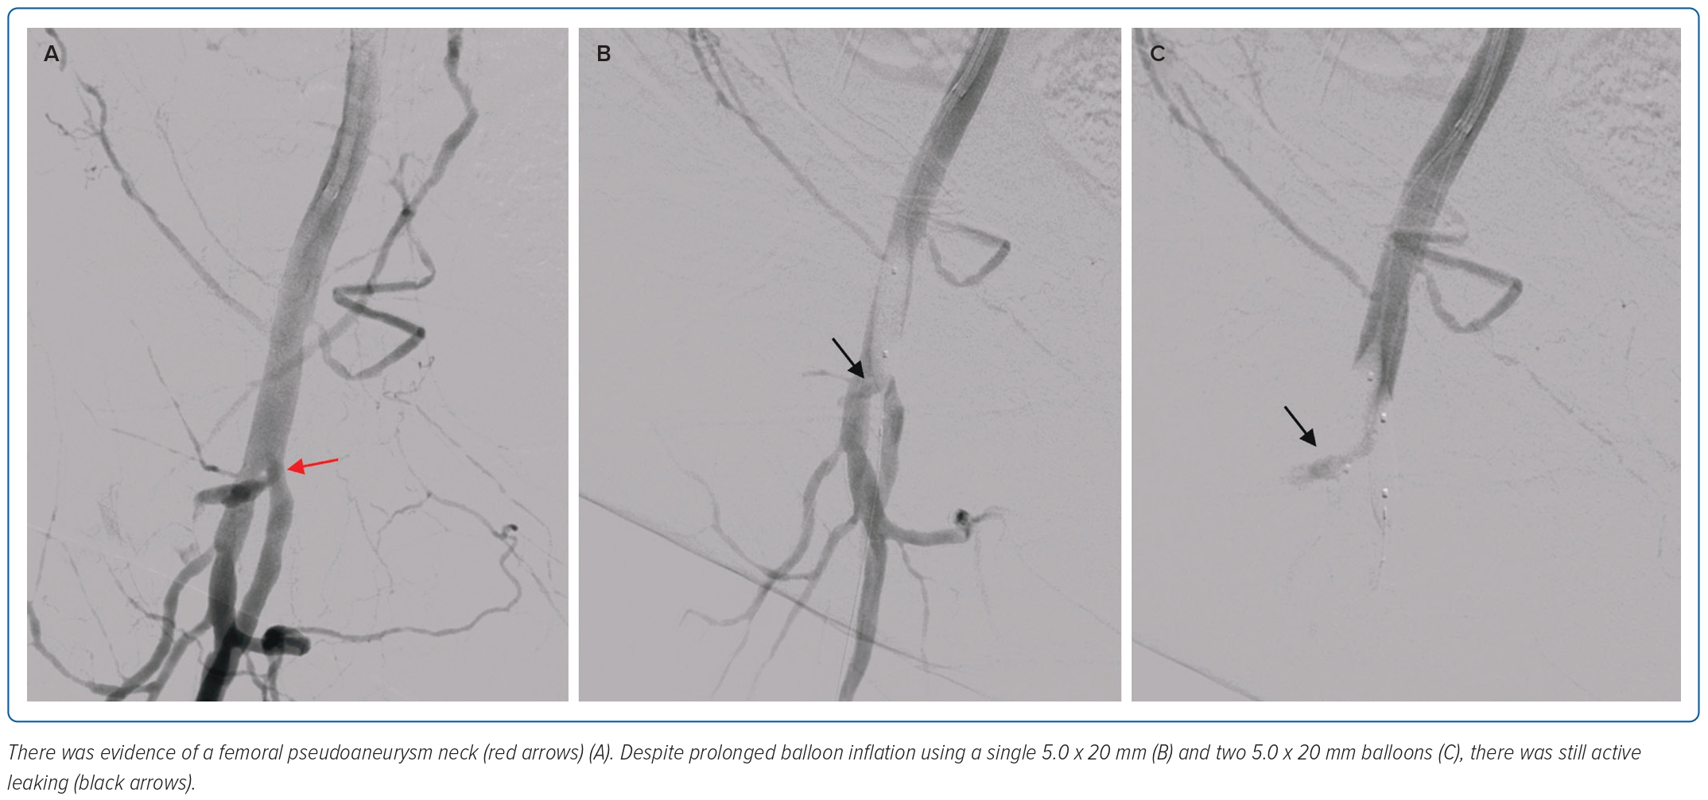
Shariff RER, Najme Khir R, Kasim SS
Figure 2: Digital Subtraction Angiography of the Right Femoral Artery and its Tributaries
Citation: Journal of Asian Pacific Society of Cardiology 2023;2:e47.
https://doi.org/10.15420/japsc.2022.20

