Slide 1
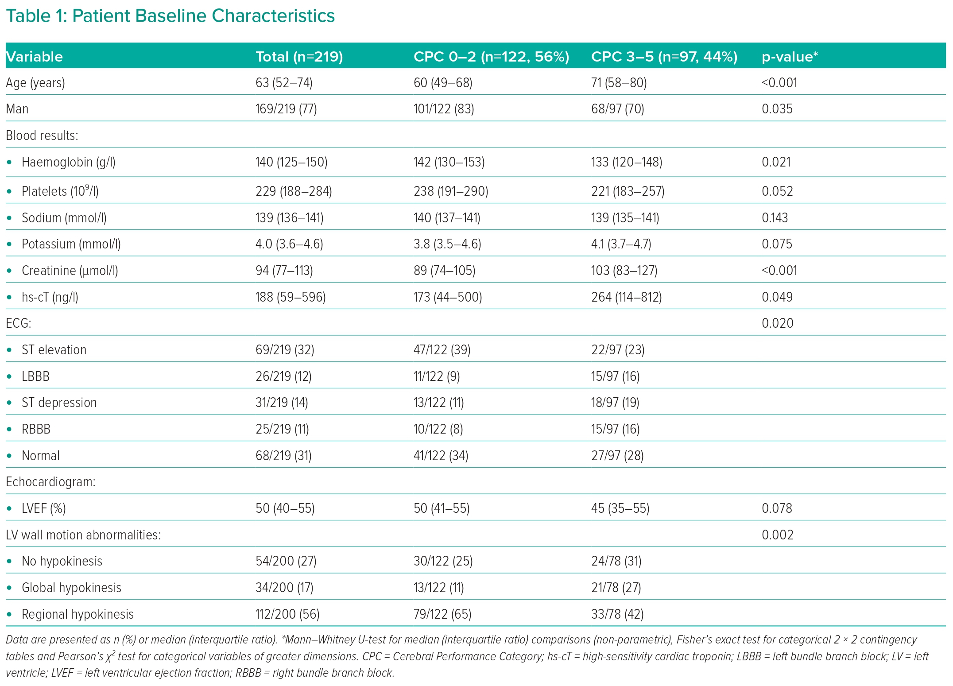
Sunderland N, Cheese F, Leadbetter Z, Joshi NV, Mariathas M, Felekos I, Biswas S, Dalton G, Dastidar A, Aziz S, McKenzie D, Raveen Kandan S, Khavandi A, Rahbi H, Bourdeaux C, Rooney K, Govier M, Thomas M, Dorman S, Strange J, Johnson TW
Patient Baseline Characteristics
Citation: Interventional Cardiology 2023;18:e29.
https://doi.org/10.15420/icr.2023.08

