Slide 1
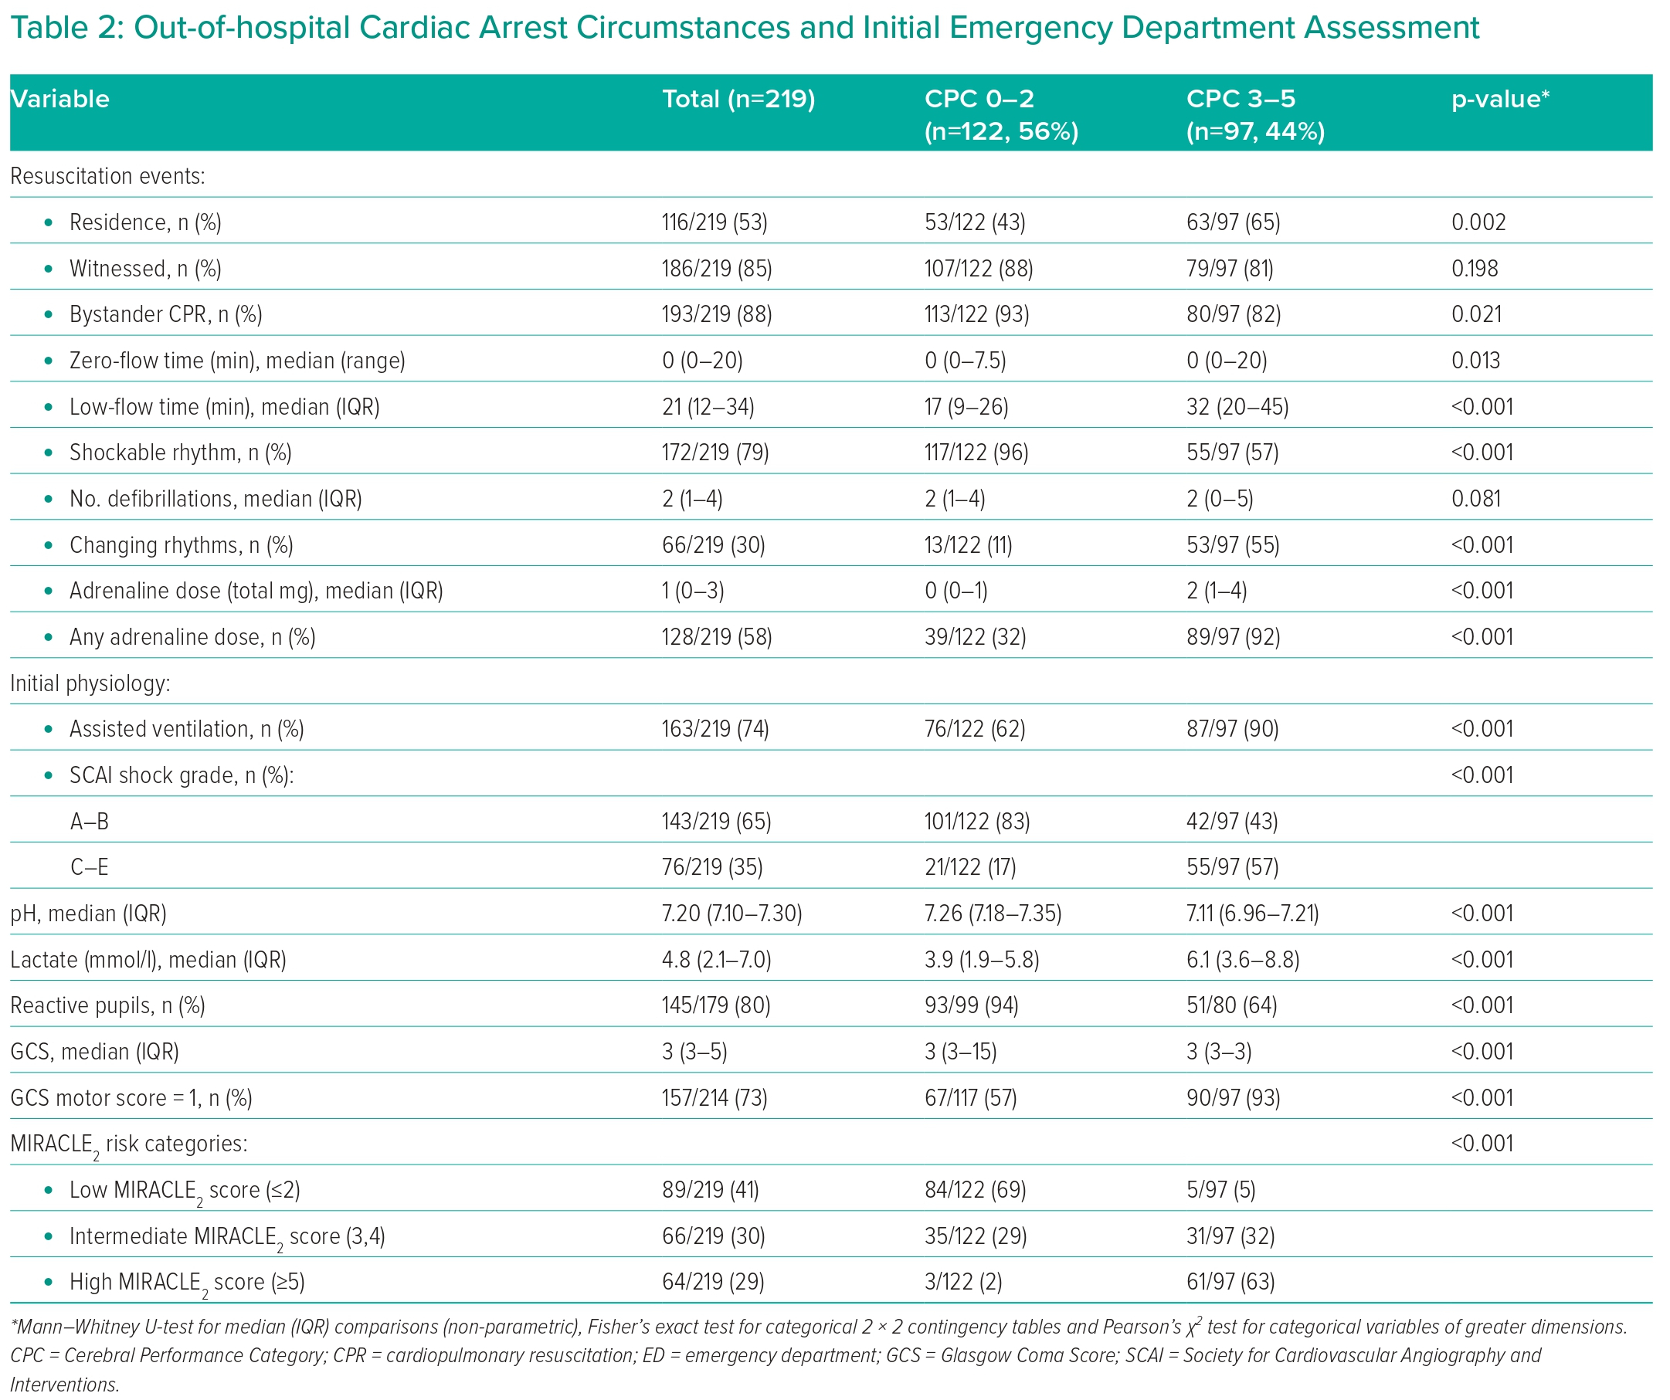
Sunderland N, Cheese F, Leadbetter Z, Joshi NV, Mariathas M, Felekos I, Biswas S, Dalton G, Dastidar A, Aziz S, McKenzie D, Raveen Kandan S, Khavandi A, Rahbi H, Bourdeaux C, Rooney K, Govier M, Thomas M, Dorman S, Strange J, Johnson TW
Out-of-hospital Cardiac Arrest Circumstances and Initial Emergency Department Assessment
Citation: Interventional Cardiology 2023;18:e29.
https://doi.org/10.15420/icr.2023.08

