Slide 1
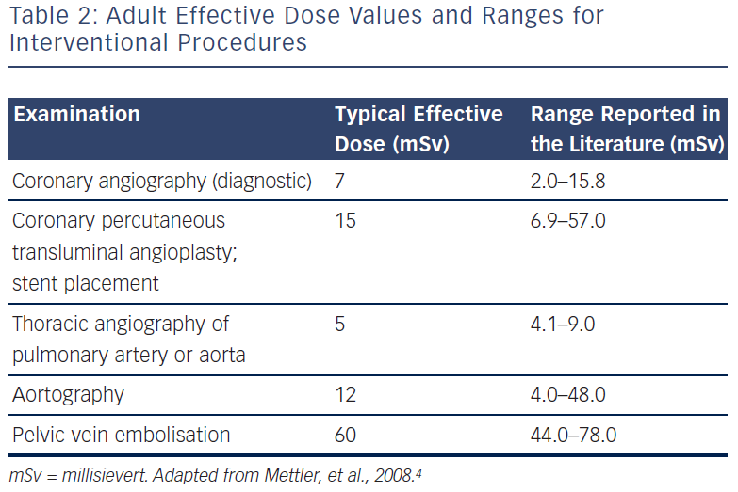
Bar O
Adult Effective Dose Values And Ranges
Citation: Interventional Cardiology Review 2013;8(1):36–40
https://doi.org/10.15420/icr.2013.8.1.36

