Slide 1
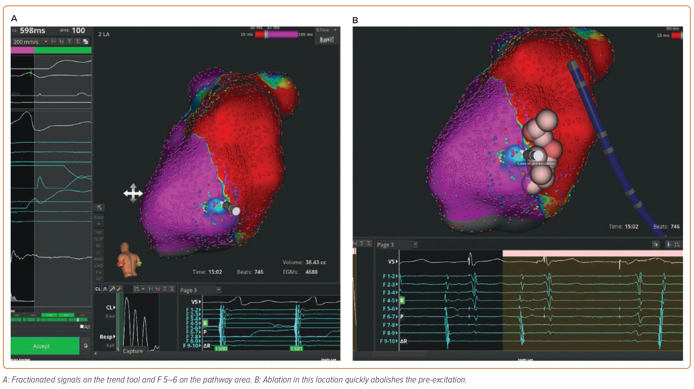
Dulai R, Bangash F, Sharma A, Cambridge A, Wong G, Lim W, Farwell D, Garcia J, Srinivasan NT
Figure 4: Case 4 – Open Window Mapping of a Manifest Left Lateral Accessory Pathway Using the Rhythmia Mapping System
Citation: Arrhythmia & Electrophysiology Review 2023;12:e28.
https://doi.org/10.15420/aer.2023.09

