Slide 1
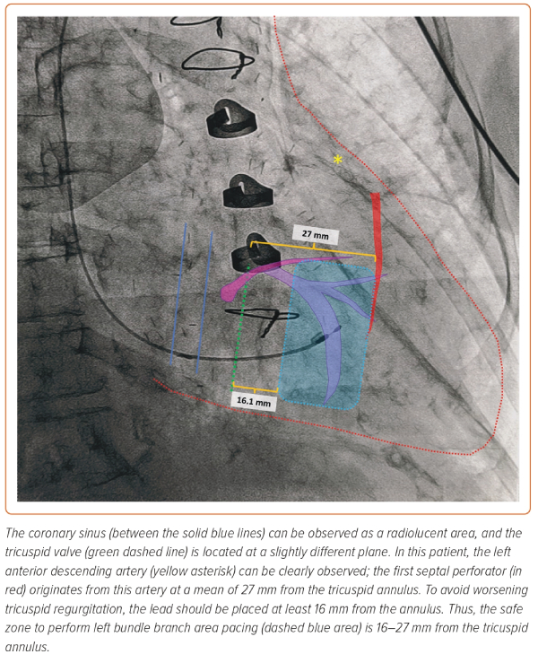
Diaz JC, Duque M, Aristizabal J, Marin J, Niño C, Bastidas O, Miguel Ruiz L, Matos CD, Hoyos C, Hincapie D, Velasco A, Romero JE
Figure 5: Right Anterior Oblique Projection Demonstrating Several Fluoroscopic Landmarks Can be Used to Avoid Procedure-related Complications During Left Bundle Branch Area Pacing
Citation: Arrhythmia & Electrophysiology Review 2023;12:e29.
https://doi.org/10.15420/aer.2023.15

