Slide 1

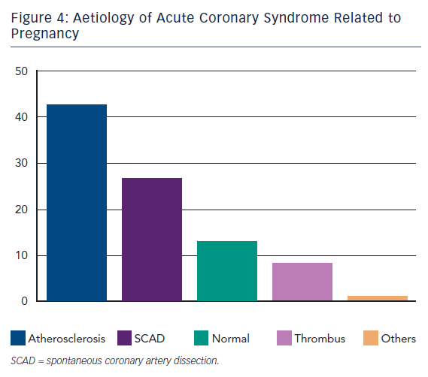
Aprigliano G, Palloshi A, Morici N, Ferraresi R, Bianchi M, Anzuini A
Acute Coronary Syndrome in Pre- and Post-partum Women – A Review
Citation: Interventional Cardiology Review 2013;8(1):8–13
https://doi.org/10.15420/icr.2013.8.1.8

