Slide 1
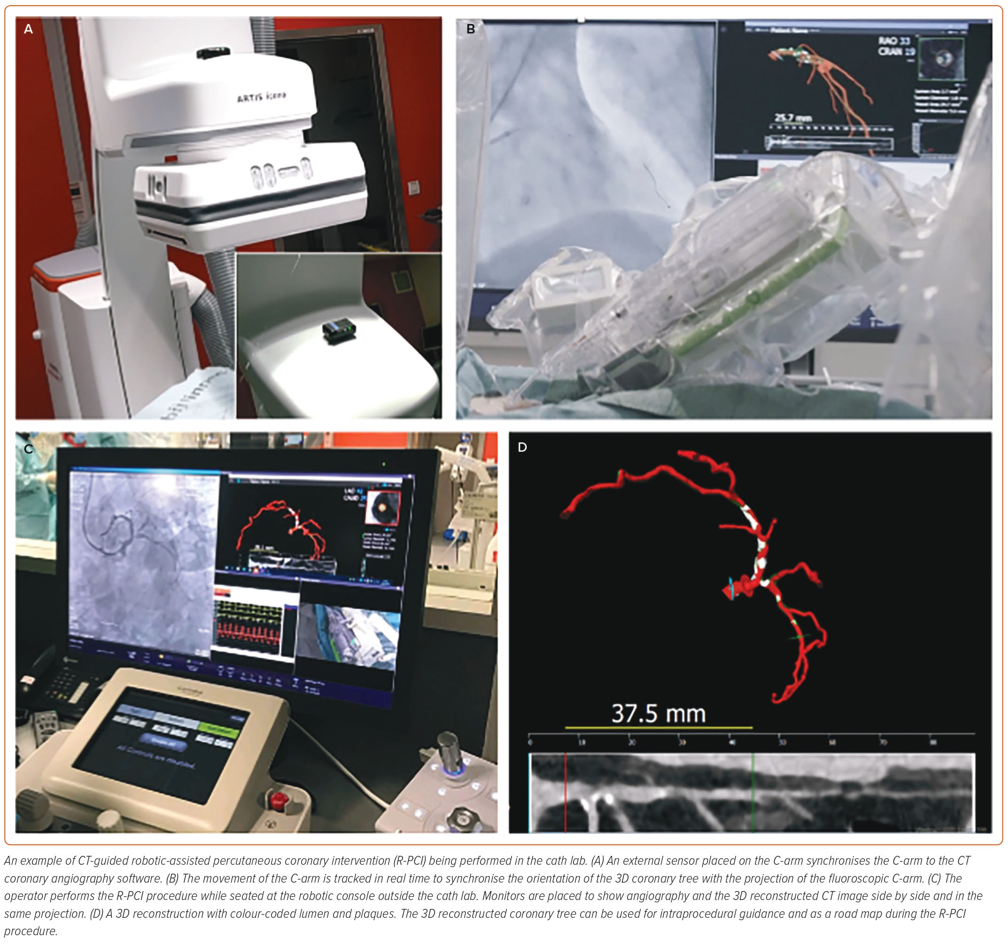
Khokhar AA, Marrone A, Bermpeis K, Wyffels E, Tamargo M, Fernández-Avilés F, Ruggiero R, Złahoda-Huzior A, Giannini F, Zelias A, Madder R, Dudek D, Beyar R
Figure 4: CT-guided Robotic-assisted Percutaneous Coronary Intervention
Citation: Interventional Cardiology 2023;18:e30
https://doi.org/10.15420/icr.2023.03

